Slide 1
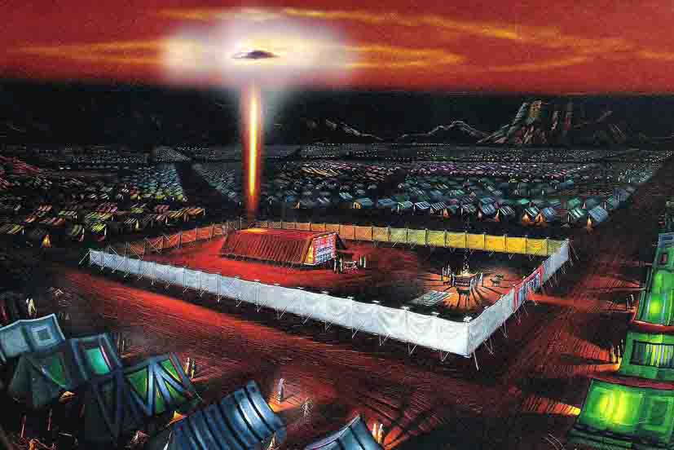
PROLOGUE

Slide 2
(1) 2 SG 299, 300
SPIRIT OF PROPHECY
Those who engage in the solemn work of bearing the third angel's message, must move out decidedly, and in the Spirit and power of God, fearlessly preach the truth, and let it cut. They should elevate the standard of truth, and urge the people to come up to it. It has been lowered down to meet the people in their condition of darkness and sin. It is the pointed testimony that will bring up the people to decide. A peaceful testimony will not do this. The people have the privilege of listening to this kind of teaching from the pulpits of the day.
Notes:
A butcher cuts to kill (satan) but a surgeon can cut in order that healing can take place (quicker, etc.). Jesus is our Great Physician.

Slide 3
(2) 2 SG 299, 300
But God has servants to whom he has entrusted a solemn, fearful message, to bring out and fit up a people for the coming of Christ. There is a great a difference in our faith and that of nominal professors, as the heavens are higher than the earth. {2SG 299.2}
The people are asleep in their sins, and need to be alarmed before they can shake off this lethargy. Their ministers have preached smooth things. God's servants, who bear sacred, vital truths. should cry aloud and spare not, that the truth may tear off the garment of security, and find its way to the heart.
Notes:
A butcher cuts to kill (satan) but a surgeon can cut in order that healing can take place (quicker, etc.). Jesus is our Great Physician.

Slide 4
(3) ISAIAH 58:1 - 4
THE HOLY SCRIPTURES
1 Cry aloud, spare not, lift up thy voice like a trumpet, and shew my people their transgression, and the house of Jacob their sins.
2 Yet they seek me daily, and delight to know my ways, as a nation that did righteousness, and forsook not the ordinance of their God: they ask of me the ordinances of justice; they take delight in approaching to God.
3 Wherefore have we fasted, say they, and thou seest not? wherefore have we afflicted our soul, and thou takest no knowledge? Behold, in the day of your fast ye find pleasure, and exact all your labours.
4 Behold, ye fast for strife and debate, and to smite with the fist of wickedness: ye shall not fast as ye do this day, to make your voice to be heard on high.
Notes:
Fasting for wrong motives. Having a fast that is not acceptable. INCORRECT FAST.

Slide 5
(4) ISAIAH 58:5 - 8
5 Is it such a fast that I have chosen? a day for a man to afflict his soul? is it to bow down his head as a bulrush, and to spread sackcloth and ashes under him? wilt thou call this a fast, and an acceptable day to the Lord?
6 Is not this the fast that I have chosen? to (1) loose the bands of wickedness, to (2) undo the heavy burdens, and to (3) let the oppressed go free, and that ye (4) break every yoke?
7 Is it not to (5) deal thy bread to the hungry, and that thou (6) bring the poor that are cast out to thy house? when thou (7) seest the naked, that thou cover him; and that thou (8) hide not thyself from thine own flesh?
Notes:
CORRECT FAST. As it should be on the Day of Atonement / in participating in the “Corresponding Work”.
What are the conditions? // What are the blessings? // Rereward (“acaph” = “awsaf”) – Gather for any purpose; Restore; Put up; Gather; Together; Assemble. // Hiding from your own flesh? See 1 John 3:17 and 1 Tim. 5:8.

Slide 6
(4) ISAIAH 58:5 - 8
8 Then shall:
1. thy light break forth as the morning, and 2. thine health shall spring forth speedily: and 3. thy righteousness shall go before thee; 4. the glory of the Lord shall be thy rereward.
Notes:
CORRECT FAST – RESULTS.
Rereward (“acaph” = “awsaf”) – Gather for any purpose; Restore; Put up; Gather; Together; Assemble. // The Glory of the Lord shall be in thy assembly or “coming together”.

Slide 7
Thy way, O God, is in the sanctuary: who is so great a God as our God? Psalm 77:13
Psalm 78:54 And he brought them to the border of his sanctuary, even to this mountain, which his right hand had purchased.
Psalm 73:12, 17: 12. Behold, these are the ungodly, who prosper in the world; they increase in riches. 17. Until I went into the sanctuary of God; then understood I their end.
Notes:
Stopped Here: At Eden Valley Church / Study Group, 2021 05 01.Ended hymn 281.
General comments:
“Thy way O God is in the sanctuary: who is so great a God as our God?”
What or whom is the “Way”? It’s Jesus! John 14:6 (KJV) “Jesus saith unto him, I am the way, the truth, and the life: no man cometh unto the Father, but by me.”
Jesus is now in the MHP not the HP. We are supposed to be wherever Jesus is so we must follow Him into the MHP. Following Jesus doesn’t mean a smooth trouble free existence. When we enlist on Jesus’ side we must expect attacks from satan. Satan is very mad at this stage of the Great Controversy…He will “mess up” anyone of us if we lay ourselves careless. 1 Peter 5:8 / 2 Tim. 3:12
Declaration:
1. Look to Jesus not the presenter.
2. Do not be distracted; listen carefully; focus on the screen.
3. A lot will be said / information given that is not on the screen.
4. Take notes and go and study for yourselves.
5. Actively participate by:
- Finding the scripture texts and other references (quickly) and reading if/when necessary.
- Children – Help with the reading of the texts.
- Read from the screen when indicated to do so.

Slide 8
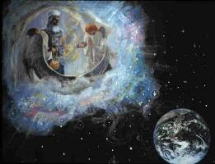
The ANTITYPICAL FAST
The Most Holy Place Experience and Overcoming Sin
Notes:
Bases for the presentation: The Bible, the Spirit of Prophecy and History!
We are to see in history the fulfillment of prophecy, to study the workings of Providence in the great reformatory movements, and to understand the progress of events in the marshaling of the nations for the final conflict of the great controversy.—Testimonies for the Church 8:307 (1904). LDE 15.2 // ISAIAH 58:6 – 12.

Slide 9
PP Chapter 22 – MOSES (pp pages 255 – 257)
Moses returned to his father-in-law and expressed his desire to visit his brethren in Egypt. Jethro's consent was given, with his blessing, "Go in peace." With his wife and children, Moses set forth on the journey. He had not dared to make known the object of his mission, lest they should not be allowed to accompany him. Before reaching Egypt, however, he himself thought it best for their own safety to send them back to the home in Midian. {PP 255.3} (256)

Slide 10
PP Chapter 22 – MOSES (pp pages 255 – 257)
A secret dread of Pharaoh and the Egyptians, whose anger had been kindled against him forty years before, had rendered Moses still more reluctant to return to Egypt; but after he had set out to obey the divine command, the Lord revealed to him that his enemies were dead. {PP 255.4}
On the way from Midian, Moses received a startling and terrible warning of the Lord's displeasure. An angel appeared to him in a threatening manner, as if he would immediately destroy him. No explanation was given; but Moses remembered that he had disregarded one of God's requirements; yielding to the (256) persuasion of his wife, he had neglected to perform the rite of circumcision upon their youngest son.

Slide 11
Cont’d.
He had failed to comply with the condition by which his child could be entitled to the blessings of God's covenant with Israel; and such a neglect on the part of their chosen leader could not but lessen the force of the divine precepts upon the people. Zipporah, fearing that her husband would be slain, performed the rite herself, and the angel then permitted Moses to pursue his journey. In his mission to Pharaoh, Moses was to be placed in a position of great peril; his life could be preserved only through the protection of holy angels. But while living in neglect of a known duty, he would not be secure; for he could not be shielded by the angels of God. {PP 255.5}
In the time of trouble just before the coming of Christ, the righteous will be preserved through the ministration of heavenly angels; but there will be no security for the transgressor of God's law. Angels cannot then protect those who are disregarding one of the divine precepts. {PP 256.1}

Slide 12
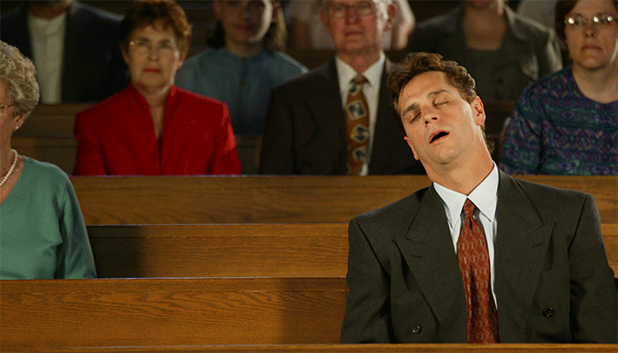
The people are asleep in their sins, and need to be alarmed before they can shake off this lethargy. Their ministers have preached smooth things; but God's servants, who bear sacred, vital truths, should cry aloud and spare not, that the truth may tear off the garment of security, and find its way to the heart. 1T 249.1 {GW92 89.3}
Notes:
2 Peter 1:12 Wherefore I will not be negligent to put you always in remembrance of these things, though ye know them, and be established in the present truth. │Mat 26:38 - 46 38 Then saith he unto them, My soul is exceeding sorrowful, even unto death: tarry ye here, and watch with me. 39 And he went a little further, and fell on his face, and prayed, saying, O my Father, if it be possible, let this cup pass from me: nevertheless not as I will, but as thou wilt. 40 And he cometh unto the disciples, and findeth them asleep, and saith unto Peter, What, could ye not watch with me one hour? 41 Watch and pray, that ye enter not into temptation: the spirit indeed is willing, but the flesh is weak. 42 He went away again the second time, and prayed, saying, O my Father, if this cup may not pass away from me, except I drink it, thy will be done. 43 And he came and found them asleep again: for their eyes were heavy. 44 And he left them, and went away again, and prayed the third time, saying the same words. 45 Then cometh he to his disciples, and saith unto them, Sleep on now, and take your rest: behold, the hour is at hand, and the Son of man is betrayed into the hands of sinners. 46 Rise, let us be going: behold, he is at hand that doth betray me. **Summary / Lesson: JESUS WAS IN A TERRIBLE CRISIS! NOT EVEN HIS DISCIPLES WAS OF ANY HELP TO HIM! THEY WERE TOO WEAK – THEY COULDN’T STAY AWAKE / WATCH! Condition of LAODICEA!

Slide 13
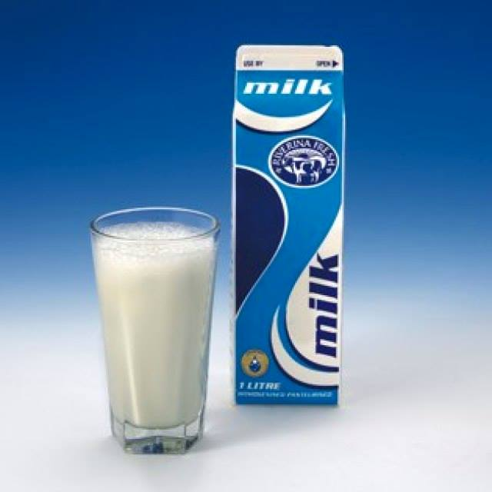
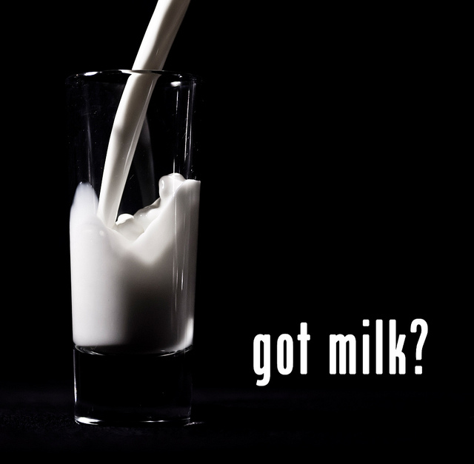
It is too late in the day to feed with milk. If souls a month or two old in the truth, who are about to enter the time of trouble such as never was, cannot hear all the straight truth, or endure the strong meat of the straightness of the way, how will they stand in the day of battle? Truths that we have been years learning must be learned in a few months by those who now embrace the Third Angel's Message. {1MR 33.4}
Notes:
Q: And, what is the 3rd Angel’s message? A: The final message of warning – against receiving the MOB - that is the Gospel that must be preached in all the world for a witness – and then shall the end come. (Matthew 24:14) See Revelation 14:13 -

Slide 14
The 3rd Angel’s Message!
9 And the third angel followed them, saying with a loud voice, If any man worship the beast and his image, and receive his mark in his forehead, or in his hand,
10 The same shall drink of the wine of the wrath of God, which is poured out without mixture into the cup of his indignation; and he shall be tormented with fire and brimstone in the presence of the holy angels, and in the presence of the Lamb:***
11 And ***the smoke of their torment ascendeth up for ever and ever: and they have no rest day nor night, who worship the beast and his image, and whosoever receiveth the mark of his name.
12 Here is the patience of the saints: here are they that keep the commandments of God, and the faith of Jesus.
Notes:
STOPPED HERE AT EDEN GARDENS 2021 06 05 The contest – the Great Controversy is all about worship! Who will you and I worship? The King of the Universe? OR Satan the arch-deceiver? The originator of sin. │Those who worship the beast and his image are starkly contrasted with those who keep the commandments of God and have the faith of Jesus!! │***So, is this just the 7 last plagues or is it also a type of the second death? c.f. Revelation 20:10; 19:3; │READ REV. 14 vv. 13 – 19: 13 And I heard a voice from heaven saying unto me, Write, Blessed are the dead which die in the Lord from henceforth: Yea, saith the Spirit, that they may rest from their labours; and their works do follow them. (Some Saints will be of “seed quality”.)
The Harvest of the Earth: 1st Harvest = The Saints:14 And I looked, and behold a white cloud, and upon the cloud one sat like unto the Son of man, having on his head a golden crown, and in his hand a sharp sickle. [See Acts 1:9 – 11, 1 Thess. 4:17 & Rev. 1:7 / = Jesus does the 1st Reaping!] 15 And another angel came out of the temple, crying with a loud voice to him that sat on the cloud, Thrust in thy sickle, and reap: for the time is come for thee to reap; for the harvest of the earth is ripe. 16 And he that sat on the cloud thrust in his sickle on the earth; and the earth was reaped. 2nd Harvest = The Wicked: 17 And another angel came out of the temple which is in heaven, he also having a sharp sickle. 18 And another angel came out from the altar, which had power over fire; and cried with a loud cry to him that had the sharp sickle, saying, Thrust in thy sharp sickle, and gather the clusters of the vine of the earth; for her grapes are fully ripe. 19 And the angel thrust in his sickle into the earth, and gathered the vine of the earth, and cast it into the great winepress of the wrath of God.

Slide 15
PRESENT TRUTH, PRECIOUS TRUTH
There are many precious truths contained in the Word of God, but it is "present truth" that the flock needs now. I have seen the danger of the messengers running off from the important points of present truth, to dwell upon subjects that are not calculated to unite the flock and sanctify the soul. Satan will here take every possible advantage to injure the cause. {EW 63.1} Q. What may those be? Answer:
But such subjects as the sanctuary, in connection with the 2300 days, the commandments of God and the faith of Jesus, are perfectly calculated to explain the past Advent movement and show what our present position is, establish the faith of the doubting, and give certainty to the glorious future. These, I have frequently seen, were the principal subjects on which the messengers should dwell.
Notes:
1. Unite the flock and 2. Sanctify the soul – John 17:14 - 24.

Slide 16
The 3rd Angel’s message is a part of the PRESENT TRUTH!
2 Peter 1:12 King James Version (KJV)
¹² Wherefore I will not be negligent to put you always in remembrance of these things, though ye know them, and be established in the present truth.
Notes:
“These things” – Assignment: Please study verses 1 – 11.
Satan is not happy with the Remnant Church and particularly those living, preaching and teaching the present truth!! Because present truth tells us what we should be doing now and that when we do it Satan’s head will be crushed!!

Slide 17
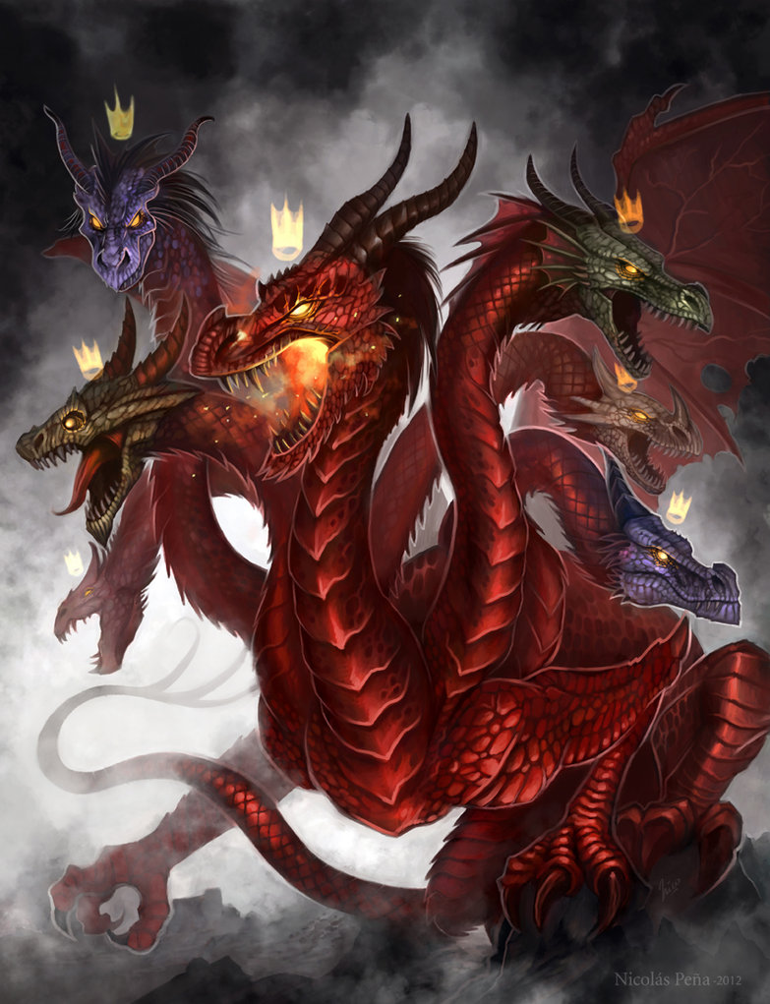
And the dragon was wroth with the woman, and went to make war with the remnant of her seed, which keep the commandments of God, and have the testimony of Jesus Christ.
Revelation 12:17
WAR WITH THE REMNANT!!!
Notes:
Allow a child to read Revelation 12:17 // A Good Weapon for us to have: Satan’s plan for God’s Church: TM 472.1 – 475.2 / GC 337 – 340 (1884) /GC Chapter 32: Snares of Satan.
What is the REAL issue? Why does satan hate God’s Remnant Church? (Decalogue! Overcoming Sin! Sanctuary! Most Holy Place Experience! See Lev. 23:26-32) │Will God’s Church fall? (LDE 180.5 / 3 SM 380.2) │The church may appear as about to fall, but it does not fall. It remains, while the sinners in Zion will be sifted out--the chaff separated from the precious wheat. This is a terrible ordeal, but nevertheless it must take place. │As the storm approaches, a large class who have professed faith in the third angel's message, but have (181) not been sanctified through obedience to the truth, abandon their position and join the ranks of the opposition. GC 608 (1911). {LDE 180.6} │How can we overcome sin? (John 1:12, 1 John 3, etc.) How can we overcome Satan? (Rev. 12:11 / 14:12; James 4:7) │

Slide 18
REVELATION 19:10
And I fell at his feet to worship him. And he said unto me, See thou do it not: I am thy fellowservant, and of thy brethren that have the testimony of Jesus: worship God: for the testimony of Jesus is the spirit of prophecy.
Notes:
God knows we will need the Spirit of Prophecy – So He ensured that His Remnant Church was blessed with it. It’s existence in the church is one of the identifying marks of God’s true Remnant People!

Slide 19
The foundation has been laid!

Slide 20

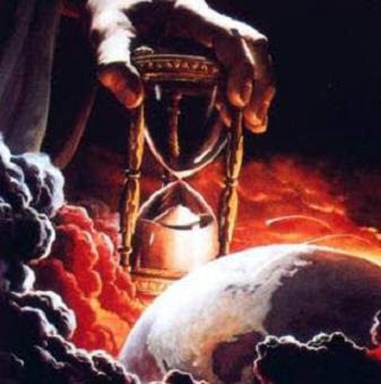

Tuesday, Oct. 22, 1844
The ANTITYPICAL FAST
THE TEN (10) COMMANDMENTS
THE MOST HOLY PLACE
Notes:
What time is it? Where is Jesus now? What is He doing? What is He using as the standard?

Slide 21
THE EARTHLY INFERIOR TO THE HEAVENLY
On the Day of Atonement the high priest, having taken an offering from the congregation, went into the most holy place with the blood of this offering, and sprinkled it upon the mercy seat, directly over the law, to make satisfaction for its claims. Then, in his character of mediator, he took the sins upon himself and bore them from the sanctuary. Placing his hands upon the head of the scapegoat, he confessed over him all these sins, thus in figure transferring them from himself to the goat. The goat then bore them away, and they were regarded as forever separated from the people. {GC 420.1}
Notes:
(Sabbath morning) STOPPED HERE ON 2021 – 08 – 14. (Note: Used DA 27.3 & 28.1 for consideration soon after start. Gave 3 texts for Scripture Reading to 3 persons to read … voluntarily: Rev. 21:27, John 10:27 & Daniel 8:14). Cleansing the Sanctuary – We MUST send on our sins, through confession and repentance. We must overcome sin, There is no option here. Help us LORD.

Slide 22
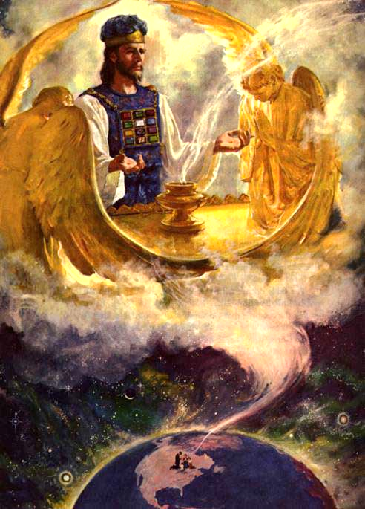
Christ is in the heavenly sanctuary!
Christ is in the heavenly sanctuary, and he is there to make an atonement for the people. He is there to present his wounded side and pierced hands to his Father. He is there to plead for his Church that is upon the earth. He is cleansing the sanctuary from the sins of the people. What is our work?—It is our work to be in harmony with the work of Christ. By faith we are to work with him, to be in union with him. {RH January 28, 1890, par. 7}
Notes:
How serious do we really take prayer? The incense burns and gives a sweet odour from the golden censer – and that is what represents our prayers. Our prayer conversations of confessions of sin and desire to be victorious over sin and satan, of wanting to be like Jesus, prayers of agony, prayers of faith – if even a mustard seed; prayers of our desires to be one and ultimately to be with God forever. Our prayer conversations are what are presented before the Father by Jesus on our behalf - our sins are sent ahead, transferred as it were to the Sanctuary...when the Sanctuary is then cleansed - your sins and my sins – are transferred to the scapegoat…SO, WE NEED TO GET OUR SINS OFF OF US!! NEXT STEP = DO NOT SIN ANYMORE…IF WE DON’T STOP SINNING WHEN WILL THE SANCTUARY BE CLEANSED? (The corresponding work we have to do!)

Slide 23
Hatred against the testimony of Jesus
The scripture which above all others had been both the foundation and the central pillar of the advent faith was the declaration: “Unto two thousand and three hundred days; then shall the sanctuary be cleansed.” Daniel 8:14 CIHS 87.1
There will be a hatred kindled against the testimonies which is satanic. The workings of Satan will be to unsettle the faith of the churches in them, for this reason: Satan cannot have so clear a track to bring in his deceptions and bind up souls in his delusions if the warnings and reproofs and counsels of the Spirit of God are heeded.—Letter 40, 1890. {1SM 48.4}
Notes:
It remains the central pillar.
WARNING – A message informing of danger / Admonish or counsel in terms of someone's behavior. (How important are warnings? Are they necessary? In what way can they help us?)
REPROOF – An act or expression of criticism and censure. [Criticism - Disapproval expressed by pointing out faults or shortcomings. A serious examination and judgment of something. Censure - ] Are reproofs important? How important are reproofs? Are reproofs usually welcomed?
COUNSEL - Direction or helpful suggestions regarding a decision or future course of action. Give advice to. // Are counsels important? How important? Are they always welcomed? Are they always followed?
Reference: Revelation 3: 14-22 – Laodicea has no commendations from Jesus – Only reproofs (rebukes) and counsels (advice)…and warning (v. 17 “…knowest not that thou art wretched…”

Slide 24
THE CROSS OF CALVARY
The Sacrifice of Christ as an atonement for sin is the great truth around which all other truths cluster. In order to be rightly understood and appreciated, every truth in the Word of God, from Genesis to Revelation, must be studied in the light that streams from the cross of Calvary. I present before you the great, grand monument of mercy and regeneration, salvation and redemption,—the Son of God uplifted on the cross. This is to be the foundation of every discourse given by our ministers.—Gospel Workers, 315. {7ABC 457.3}
Notes:
We have many problems because we do not focus on Jesus Christ!! While Jesus is there in / ministering in the Sanctuary – The key event that makes it even possible for Him to be there – Is the fact that He died on the cross at Calvary!! Praise God!!! Christ work in the Sanctuary represents stages or steps in the plan of redemption – The cross is the step that really FULFILLS / CONCRETIZES / MAKES REAL the beginning of the process…and yet is the grand part of the end of the process! (He Himself is the sacrifice required on the Day of Atonement! But He already died on the cross!)

Slide 25
Preaching the Sanctuary Doctrine Endorsed by Holy Spirit—For more than half a century the different points of present truth have been questioned and opposed. New theories have been advanced as truth, which were not truth, and the Spirit of God revealed their error. As the great pillars of our faith have been presented, the Holy Spirit has borne witness to them, and especially is this so regarding the truths of the sanctuary question. Over and over again the Holy Spirit has in a marked manner endorsed the preaching of this doctrine. But today, as in the past, some will be led to form new theories and to deny the truths upon which the Spirit of God has placed His approval.—Manuscript 125, 1907. {Ev 224.2}
Notes:
Prediction May 25, 1905.
1 SM 48.3, 4 (Prediction 1890) – “The very last deception of satan…” / satanic hatred against the testimonies.
5T 671 – “This work is of God, or it is not…”
5T 691 – “I entreat you not to interpose between me and the people, and turn away the light which God would have come to them.”
3SM 83 – “Acknowledge the gift that has been placed in the church for the guidance of God’s people in the closing days of earth’s history.”
3SM 84 – “One thing is certain: Those Seventh-day Adventists who take their stand under Satan’s banner will first give up their faith in the warnings and reproofs contained in the Testimonies of God’s Spirit.”
EV 362 – “They remove the old landmarks, and fallacies and winds of doctrine blow them hither and thither.”

Slide 26
False Theories Regarding the Sanctuary—In the future, deception of every kind is to arise, and we want solid ground for our feet. We want solid pillars for the building. Not one pin is to be removed from that which the Lord has established. The enemy will bring in false theories, such as the doctrine that there is no sanctuary. This is one of the points on which there will be a departing from the faith. Where shall we find safety unless it be in the truths that the Lord has been giving for the last fifty years?—The Review and Herald, May 25, 1905. {Ev. 224.3}
Seriousness of Sanctuary Truth—While Christ is cleansing the sanctuary, the worshipers on earth should carefully review their life, and compare their character with the standard of righteousness.—The Review and Herald, April 8, 1890. {Ev. 224.1}
Notes:
(Sabbath afternoon) STOPPED HERE: 2021 – 08 – 14 (Note: SR = Luke 4:16 – 20; Presentation done on the verandah and I sat to present. God is Good!! God blessed!) Prediction May 25, 1905.
1 SM 48.3, 4 (Prediction 1890) – “The very last deception of satan…” / satanic hatred against the testimonies.
5T 671 – “This work is of God, or it is not…”
5T 691 – “I entreat you not to interpose between me and the people, and turn away the light which God would have come to them.”
3SM 83 – “Acknowledge the gift that has been placed in the church for the guidance of God’s people in the closing days of earth’s history.”
3SM 84 – “One thing is certain: Those Seventh-day Adventists who take their stand under Satan’s banner will first give up their faith in the warnings and reproofs contained in the Testimonies of God’s Spirit.”
EV 362 – “They remove the old landmarks, and fallacies and winds of doctrine blow them hither and thither.”

Slide 27
If Seventh-day Adventists practiced what they profess to believe, if they were sincere health reformers, they would indeed be a spectacle to the world, to angels, and to men. And they would show a far greater zeal for the salvation of those who are ignorant of the truth. {CH 575.1}
Notes:
A word on obedience in health reform. So, Health Reform has something to do with Evangelism?

Slide 28
Greater reforms should be seen among the people who claim to be looking for the soon appearing of Christ. Health reform is to do among our people a work which it has not yet done. There are those who ought to be awake to the danger of meat eating, who are still eating the flesh of animals, thus endangering the physical, mental, and spiritual health. Many who are now only half converted on the question of meat eating will go from God’s people, to walk no more with them. {CH 575.2}
Notes:
What does it mean to be “half converted”? │The paramount importance of diet!! Satan is still – in a great measure – attaining much success in overthrowing god’s people – because we are not getting health reform right and especially diet reform…satan has the world in his vice-grip! God’s people need to be different from the world…so he can use us to finish the work!!! │Where do you stand in this? Where do I stand? │Does spiritual health have anything to do with God’s commandments?

Slide 29

THE MOST HOLY PLACE
James 2:10, 12
THE TEN (10) COMMANDMENTS
Notes:
So, what is the fast we are to have today? The antitypical fast?

Slide 30
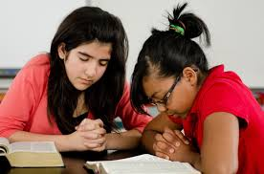
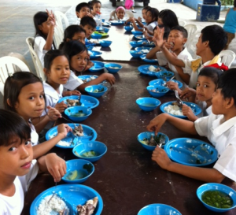
AA 560 Practical godliness
Character Purified
Character Elevated
Character Ennobled
Character Glorified
Pure doctrine - Works of righteousness.
Heavenly precepts - Holy practices.
Notes:
What is Jesus’ ultimate aim for us?? HOW will we reach that state?? We must have the “Most Holy Place Experience” if we are to be overcomers! We need to be fasting! REVISIT the early slide on the fast in Isaiah! (#5)

Slide 31
Verse 23 - EGW comments
The children of God are called to be representatives of Christ, showing forth the goodness and mercy of the Lord. As Jesus has revealed to us the true character of the Father, so we are to reveal Christ to a world that does not know His tender, pitying love. {SC 115.1}
Christians are set as light bearers on the way to heaven. They are to reflect to the world the light shining upon them from Christ. Their life and character should be such that through them others will get a right conception of Christ and of His service. {SC 115.2}
Notes:
SC pages 115, 116. Who is the source of the light? We are mere reflectors of the light.

Slide 32
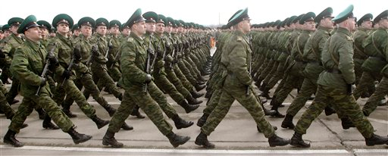
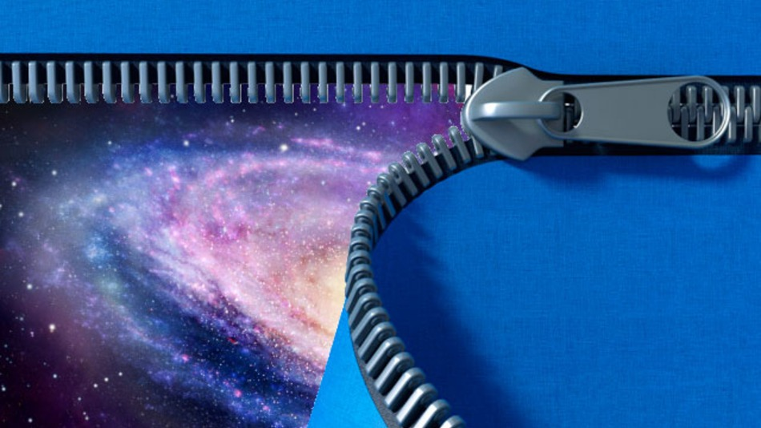
A Company of soldiers
Said the angel, “List ye!” Soon I heard a voice like many musical instruments all sounding in perfect strains, sweet and harmonious. It surpassed any music I had ever heard, seeming to be full of mercy, compassion, and elevating, holy joy. It thrilled through my whole being. Said the angel, “Look ye!” My attention was then turned to the company I had seen, who were mightily shaken. I was shown those whom I had before seen weeping and praying in agony of spirit. The company of guardian angels around them had been doubled, and they were clothed with an armor from their head to their feet. They moved in exact order, like a company of soldiers. Their countenances expressed the severe conflict which they had endured, the agonizing struggle they had passed through. Yet their features, marked with severe internal anguish, now shone with the light and glory of heaven. They had obtained the victory, and it called forth from them the deepest gratitude, and holy, sacred joy. {CET 176.3}
Notes:
Chapter 30: The Shaking. WHAT FINAL EVENT WILL SHAKE THE CHURCH TO ITS CORE???
Did the early church / the Disciples experience a shaking? Did they unite and became as one? Was the early rain poured out before they were united? Why was unity a requirement? Do we today need to be united? Will the latter rain fall on a fractious, fragmented church with a multiplicity of “true paths”. How many Gospels were the disciples to preach? What is the Gospel that we should be preaching today?
[3 ANGELS / SANCTUARY / VICTORY OVER SIN] │Was the Remnant Church the result of a shaking?

Slide 33
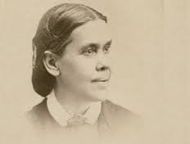
“Not one of us will ever receive the seal of God while our characters have one spot or stain upon them. It is left with us to remedy the defects in our characters, to cleanse the soul-temple of every defilement. Then the latter rain will fall upon us as the early rain fell upon the disciples on the day of Pentecost.” {CET 189.2}

Slide 34
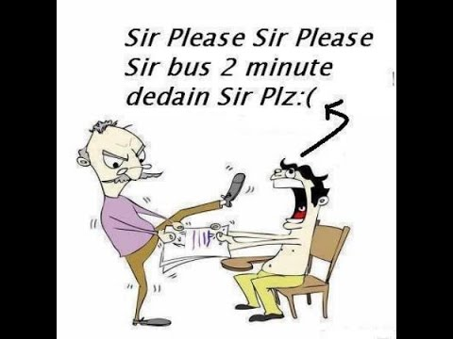
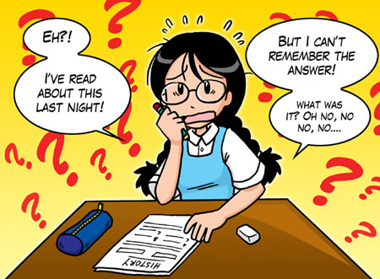

It is in a crisis that character is revealed. When the earnest voice proclaimed at midnight, “Behold, the bridegroom cometh; go ye out to meet him,” and the sleeping virgins were roused from their slumbers, it was seen who had made preparation for the event. Both parties were taken unawares; but one was prepared for the emergency, and the other was found without preparation. So now, a sudden and unlooked-for calamity, something that brings the soul face to face with death, will show whether there is any real faith in the promises of God. It will show whether the soul is sustained by grace. The great final test comes at the close of human probation, when it will be too late for the soul’s need to be supplied. {COL 412.1}
Notes:
[THE MOB] Prepare for an Overwhelming Surprise—Transgression has almost reached its limit. Confusion fills the world, and a great terror is soon to come upon human beings. The end is very near. God’s people should be preparing for what is to break upon the world as an overwhelming surprise. {CG 555.2} │Our time is precious. We have but a few, a very few, days of probation in which to make ready for the future, immortal life.2 {CG 555.3} │Christians should be preparing for what is soon to break upon the world as an overwhelming surprise, and this preparation they should make by diligently studying the word of God, and striving to conform their lives to its precepts.... God calls for a revival and a reformation.—Prophets and Kings, 626. {ChS 41.3}

Slide 35
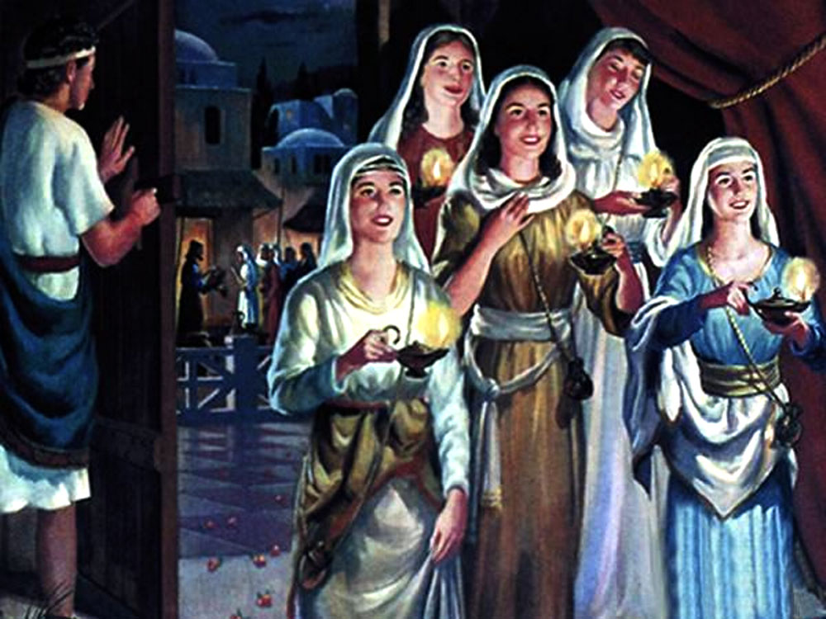
COL 412.2
The ten virgins are watching in the evening of this earth’s history. All claim to be Christians. All have a call, a name, a lamp, and all profess to be doing God’s service. All apparently wait for Christ’s appearing. But five are unready. Five will be found surprised, dismayed, outside the banquet hall. {COL 412.2}
Notes:
STOPPED HERE: SW 4, AUGUST 27, 2016 – DID NOT GO TO NOTES THOUGH. ALSO NO REFERENCE TO THE PICTURE ILLUSTRATING THE DOOR BEING SHUT AND THE FOOLISH ONES OUTSIDE.
MATTHEW 25:1-13 // How comes they are unready? What makes the difference? │The Holy Spirit – the oil – the Holy Spirit is the one that develops in us the character of Christ! This is what the Lord can accomplish in us when we enter the most holy place experience – and desire to be obedient to God by keeping his commandments! So, is a mere profession enough?? Lord please help us!!

Slide 36
AA 306.3
The apostle plainly outlined the result of turning from a life of purity and holiness to the corrupt practices of heathenism. “Be not deceived,” he wrote; “neither fornicators, nor idolaters, nor adulterers, ... nor thieves, nor covetous, nor drunkards, nor revilers, nor extortioners, shall inherit the kingdom of God.” He begged them to control the lower passions and appetites. “Know ye not,” he asked, “that your body is the temple of the Holy Ghost which is in you, which ye have of God?” {AA 306.3}
Notes:
HOW CAN ALL THIS BE ACHIEVED?...?

Slide 37
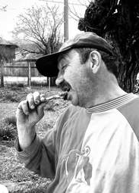
The antitypical fast
The Most Holy Place Experience and Overcoming Sin

Slide 38
THE ANTITYPICAL FAST
Leviticus 16:
29 And this shall be a statute for ever unto you: that in the seventh month, on the tenth day of the month, ye shall afflict your souls, and do no work at all, whether it be one of your own country, or a stranger that sojourneth among you:
30 For on that day shall the priest make an atonement for you, to cleanse you, that ye may be clean from all your sins before the Lord.
31 It shall be a sabbath of rest unto you, and ye shall afflict your souls, by a statute for ever.
Notes:
Reading assignment – Leviticus 16 & 23.
Afflict - To give to the body or mind pain which is continued or of some permanence; to grieve, or distress;
The Day of Atonement was a very solemn day – Preceded by the Feast of Trumpet on the first day of the month and followed by the Feast of Tabernacles on the fifteenth day of the month!!!

Slide 39
Leviticus 23:
26 And the Lord spake unto Moses, saying,
27 Also on the tenth day of this seventh month there shall be a day of atonement: it shall be an holy convocation unto you; and ye shall afflict your souls, and offer an offering made by fire unto the Lord.
28 And ye shall do no work in that same day: for it is a day of atonement, to make an atonement for you before the Lord your God.
29 For whatsoever soul it be that shall not be afflicted in that same day, he shall be cut off from among his people.
Notes:
Offering made by fire – Romans 12:1, 2 - I beseech you therefore, brethren, by the mercies of God, that ye present your bodies a living sacrifice, holy, acceptable unto God, which is your reasonable service.
² And be not conformed to this world: but be ye transformed by the renewing of your mind, that ye may prove what is that good, and acceptable, and perfect, will of God.

Slide 40
THE ANTITYPICAL FAST
30 And whatsoever soul it be that doeth any work in that same day, the same soul will I destroy from among his people.
31 Ye shall do no manner of work: it shall be a statute for ever throughout your generations in all your dwellings.
32 It shall be unto you a sabbath of rest, and ye shall afflict your souls: in the ninth day of the month at even, from even unto even, shall ye celebrate your sabbath.
Notes:
Do no manner of work – This goes back to earlier quotations! (Controlling the lower passions and appetite, AA 306.3 etc.) Ephesians 5 (Have it read from verse 1!): ¹¹ And have no fellowship with the unfruitful works of darkness, but rather reprove them. ¹² For it is a shame even to speak of those things which are done of them in secret.

Slide 41
The prophet of the remnant church:
Comment on vv. 29 - 31
Every man was required to afflict his soul while this work of atonement was going forward. All business was to be laid aside, and the whole congregation of Israel were to spend the day in solemn humiliation before God, with prayer, fasting, and deep searching of heart. {GC 419.3}
Notes:
These must be typical of our entire lifestyle today!! READING ASSIGNMENT – GC CHAPTER 23: “WHAT IS THE SANCTUARY?”

Slide 42
Let’s look at the context of the quote
The whole ceremony was designed to impress the Israelites with the holiness of God and His abhorrence of sin; and, further, to show them that they could not come in contact with sin without becoming polluted.

Slide 43
Let’s look at the context of the quote
Important truths concerning the atonement are taught by the typical service. A substitute was accepted in the sinner's stead; but the sin was not canceled by the blood of the victim. A means was thus provided by which it was transferred to the sanctuary.

Slide 44
Let’s look at the context of the quote
By the offering of blood the sinner acknowledged the authority of the law, confessed his guilt in transgression, and expressed his desire for pardon through faith in a Redeemer to come; but he was not yet entirely released from the condemnation of the law.
Notes:
ARE YOU GETTING THE PICTURE THAT IT’S ALL ABOUT SIN AND GETTING RID OF SIN AND RESTORING GOD’S IMAGE IN MAN? The antitypical fast is to abstain – not from food as in the typical…but - from – sin!! To - get – rid - of - sin - out - of – our - lives!! (No wonder Satan hates these messages!!)

Slide 45
Let’s look at the context of the quote
On the Day of Atonement the high priest, having taken an offering from the congregation, went into the most holy place with the blood of this offering, and sprinkled it upon the mercy seat, directly over the law, to make satisfaction for its claims.

Slide 46
Let’s look at the context of the quote
Then, in his character of mediator, he took the sins upon himself and bore them from the sanctuary. Placing his hands upon the head of the scapegoat, he confessed over him all these sins, thus in figure transferring them from himself to the goat.
Notes:
Satan is the scapegoat!! That’s why he hates God’s church so much and is warring against the church and wants to destroy the church!! It boils down to an individual matter… Why on the head of the scapegoat? Read Genesis 3:15…It shows how satan will end…HE – WILL - LOSE!!! HALLELUJAH!!! He will be relegated to the antitypical wilderness – for a thousand years! The he will be finally OBLITERATED!!! Read Ezekiel 28:18.

Slide 47
Let’s look at the context of the quote:
The goat then bore them away, and they were regarded as forever separated from the people. {GC 420.1}
Notes:
What’s the them? (The sins of the people – antitypically; our sins!!) / Back to the quote regarding the sealing - CET 189.2 (Slide # __)

Slide 48
Let’s look at the context of the quote:
Such was the service performed "unto the example and shadow of heavenly things." And what was done in type in the ministration of the earthly sanctuary is done in reality in the ministration of the heavenly sanctuary.
Notes:
Amen?

Slide 49
WHAT ELSE ABOUT THE ANTITYPICAL FAST…?
Proverbs 2:3 - 5 / Proverbs 8:13

Slide 50
Proverbs 2:3-5 King James Version (KJV)
3 Yea, if thou criest after knowledge, and liftest up thy voice for understanding;
4 If thou seekest her as silver, and searchest for her as for hid treasures;
5 Then shalt thou understand the fear of the lord, and find the knowledge of god.
Notes:
Revelation 14:6,7 “Fear God and give glory to Him for the hour of His judgment is come…”

Slide 51
Proverbs 8:13 King James Version (KJV)
13. The fear of the Lord is to hate evil: pride, and arrogancy, and the evil way, and the froward mouth, do I hate.
Notes:
Pride – Inordinate self-esteem; an unreasonable conceit of one's own superiority in talents, beauty, wealth, accomplishments, rank or elevation in office, which manifests itself in lofty airs, distance, reserve, and often in contempt of others.
/ Proverbs 16:18 Pride goeth before destruction, and an haughty spirit before a fall.
Arrogancy – Arrogance; The act or habit of arrogating, or making undue claims in an overbearing manner; that species of pride which consists in exorbitant claims of rank, dignity, estimation, or power, or which exalts the worth or importance of the person to an undue degree; proud contempt of others; lordliness; haughtiness; self-assumption; presumption.
The evil way -
Froward mouth - Perverse, that is, turning from, with aversion or reluctance; not willing to yield or comply with what is required; unyielding; ungovernable; refractory; disobedient; peevish; as a froward child. Read Matthew 12:34 and Luke 6:45.

Slide 52
QUESTION: WHAT’S INSIDE THE ARK OF THE COVENANT?
DO THEY HAVE ANY SIGNIFICANCE FOR THE ANTITYPICAL FAST?
Notes:
Reading assignment:
The prophet’s vision of the heavenly sanctuary CET Chapter 12: The Heavenly Sanctuary

Slide 53
INSIDE THE ARK OF THE COVENANT –
THE ANTITYPICAL FAST
Hebrews 9:3, 4
And after the second veil, the tabernacle which is called the Holiest of all;
4 Which had the golden censer, and the ark of the covenant overlaid round about with gold, wherein was the golden pot that had manna, and Aaron's rod that budded, and the tables of the covenant;

Slide 54
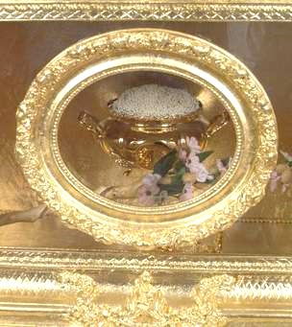
THE MOST HOLY PLACE
Inside the Ark of the Covenant
“The Golden Pot
that had Manna”
Notes:
So, what is the fast we are to have today? The antitypical fast? (Reading Assignment – Exodus 16)
1. The manna – The food we should be eating today should be as manna; as “angels’ food” – Back to the original diet! (Genesis 1:29, Gen. 3:18) // Psalm 78: ²⁴ And had rained down manna upon them to eat, and had given them of the corn of heaven. ²⁵ Man did eat angels' food: he sent them meat to the full. In the said chapter God also gave them flesh…what was the result? Was He happy with His people asking for flesh (“food”)?

Slide 55
CD 461
By precept and example make it plain that the food which God gave Adam in his sinless state is the best for man's use as he seeks to regain that sinless state.
Notes:
Reading Assignment – Counsels on Diets and Foods (1938), chapter 25: Teaching Health Principles.

Slide 56
THE MOST HOLY PLACE
Inside the Ark of the Covenant
“The Golden Pot
that had Manna”
Notes:
So, what is the fast we are to have today? The antitypical fast? (Reading assignment – Exodus 16)
(Second Point) 2. The manna was given not just to feed Israel with physical food but to test Israel’s obedience and loyalty to God, – Especially, with respect to His Sabbath! v. 4. Then said the Lord unto Moses, Behold, I will rain bread from heaven for you; and the people shall go out and gather a certain rate every day, that I may prove them, whether they will walk in my law, or no.
The manna:
i. Present in the morning (as soon as the sunlight got hot it melted away),
ii. Available daily,
iii. Any left overnight would be stink and have worms,
iv. On the Preparation Day (Friday) twice as much was to be gathered to serve for both Friday and Sabbath,
v. That which was gathered on Friday and left overnight for Sabbath did not spoil and
vi. No manna fell on the Sabbath!!

Slide 57
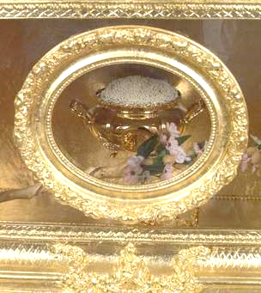
THE MOST HOLY PLACE
Inside the Ark of the Covenant
“The Golden Pot
that had Manna”
Notes:
So, what is the fast we are to have today? The antitypical fast? (Reading Assignment – Revelation chapter 3)
(Third Point) 3. The manna was in a golden pot – Why a golden pot? What did Jesus say about gold in the book of Revelation in the message to the Church at Laodicea? Rev. 3:¹⁸ I counsel thee to buy of me gold tried in the fire, that thou mayest be rich; / GOLD = Holiness (Rev. 4:4). Pure character (Isa. 13:12). Spiritual Wealth (Rev. 3:18)

Slide 58
COL 374
God desires us to choose the heavenly in place of the earthly. He opens before us the possibilities of a heavenly investment. He would give encouragement to our loftiest aims, security to our choicest treasure. He declares, "I will make a man more precious than fine gold; even a man than the golden wedge of Ophir." Isaiah 13:12. When the riches that moth devours and rust corrupts shall be swept away, Christ's followers can rejoice in their heavenly treasure, the riches that are imperishable.

Slide 59
The seal of the living God will be placed upon those only who bear a likeness to Christ in character. {OFC 83.1}
As wax takes the impression of the seal, so the soul is to take the impression of the Spirit of God and retain the image of Christ. {OFC 83.2}
It is obedience to the principles of the commandments of God, that molds the character after the divine similitude. {OFC 83.3}
OBEDIENCE
Notes:
Reading Assignment: The faith I live by chapter 3: Who shall receive god’s seal?
NOTE: While the image of the beast is being formed (As we speak! Right now!) – We should be very busy allowing the Holy Spirit to develop in us the image of Christ!!

Slide 60
Mark this point with care: Those who receive the pure mark of truth, wrought in them by the power of the Holy Ghost, represented by a mark by the man in linen, are those "that sigh and that cry for all the abominations that be done" in the church. {Mar 240.2}
The class who do not feel grieved over their own spiritual declension, nor mourn over the sins of others, will be left without the seal of God. . .
Notes:
Reading Assignment:

Slide 61
Not one of us will ever receive the seal of God while our characters have one spot or stain upon them. It is left with us to remedy the defects in our characters, to cleanse the soul temple of every defilement. Then the latter rain will fall upon us as the early rain fell upon the disciples on the Day of Pentecost. {CCh 334.1}
Notes:
Reading Assignment: Counsels for the Church, chapter 61 – The Coming Crisis.

Slide 62
Romans 12 King James Version (KJV)
12 I beseech you therefore, brethren, by the mercies of God, that ye present your bodies a living sacrifice, holy, acceptable unto God, which is your reasonable service.
² And be not conformed to this world: but be ye transformed by the renewing of your mind, that ye may prove what is that good, and acceptable, and perfect, will of God.
Notes:
Reading Assignment: Counsels for the Church, chapter 61 – The Coming Crisis.

Slide 63
THE MOST HOLY PLACE
Inside the Ark of the Covenant
“The Golden Pot
that had Manna”
Notes:
So, what is the fast we are to have today? The antitypical fast?
(Fourth Point) 4. The manna ultimately represents Jesus, the Bread of Life! [CAN YOU SEE THE CONNECTION BETWEEN THE GOLDEN POT BEING CHARACTER, ETC. AND JESUS BEING THE MANNA!!??] When we are filled up with Jesus we will have a perfect character! – like His!!
QUESTION: Did the manna in the ark ever go stink? And have worms? (It couldn’t because it represented Jesus – Who - never - saw - corruption!! He experienced no physical decaying! And – He – had NO SIN!!! Hallelujah!!!)

Slide 64
Reading assignment – john chapter six (6)
John 6:35 And Jesus said unto them, I am the bread of life: he that cometh to me shall never hunger; and he that believeth on me shall never thirst.
John 6:48 I am that bread of life.
John 6:51 I am the living bread which came down from heaven: if any man eat of this bread, he shall live for ever: and the bread that I will give is my flesh, which I will give for the life of the world.
Notes:
In John 6: Jesus had fed the multitude – The men alone numbered 5 thousand!! The multitude was fed with a little boy’s lunch consisting of five loaves and two fish!! Yet, when everybody had their full – 12 baskets full of food was collected!! Jesus later uttered the words in vv. 35, 48 & 51!! WHAT DOES ALL OF THAT TELL US FOR TODAY? HE IS ALL POWERFUL!! (Matt. 28:18) HE IS ALL SUFFICIENT!!

Slide 65
John 6:
⁴⁹ Your fathers did eat manna in the wilderness, and are dead. ⁵⁰ This is the bread which ¹cometh down from heaven, that a man may eat thereof, and not die. ⁵¹ I am the living bread which ²came down from heaven: if any man eat of this bread, he shall live for ever: and the bread that I will give is my flesh, which I will give for the life of the world.
Notes:
JUST IN CASE SOMEONE DIDN’T GET IT…How do we eat Jesus?

Slide 66
John 6:
⁵³ Then Jesus said unto them, Verily, verily, I say unto you, Except ye eat the flesh of the Son of man, and drink his blood, ye have no life in you.
⁵⁴ Whoso eateth my flesh, and drinketh my blood, hath eternal life; and I will raise him up at the last day.
⁵⁵ For my flesh is meat indeed, and my blood is drink indeed.
⁵⁶ He that eateth my flesh, and drinketh my blood, dwelleth in me, and I in him.
Notes:
Jesus must become a part of us – as we eat and drink food it makes blood and become a part of us!! How can we eat and drink Jesus Christ so that He becomes as
life-giving blood flowing through our veins and arteries?...?
Note: “raise him up at the last day” – Some will be “raised up” from the grave – and others will be “raised up” with them to meet the Lord in the air!! Dead or alive – “raised up”!!

Slide 67
More inside the ark of the covenant!
God gave each of us the power of choice! Everyone will be accountable for him or her self! Romans 14:12

Slide 68
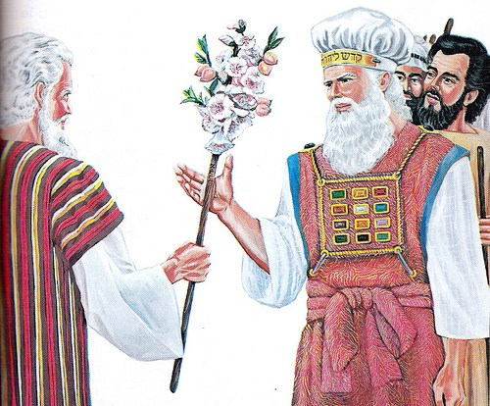
THE MOST HOLY PLACE
Inside the Ark of the Covenant
Aaron’s Rod that Budded
Notes:
(First Point) 1. Jesus’s power can resurrect the dead – the physically dead! (Lazarus – John 11:43, 44) ⁴³ And when he thus had spoken, he cried with a loud voice, Lazarus, come forth. ⁴⁴ And he that was dead came forth, bound hand and foot with graveclothes: and his face was bound about with a napkin. Jesus saith unto them, Loose him, and let him go. // But he can also resurrect the spiritually dead! Ephesians 2:1 And you hath he quickened, who were dead in trespasses and sins; (See also Eph. 1:5, Col. 2:13 and 1 Peter 2:24)

Slide 69
Numbers 17:8
And it came to pass, that on the morrow Moses went into the tabernacle of witness; and, behold, the rod of Aaron for the house of Levi was budded, and brought forth buds, and bloomed blossoms, and yielded almonds.
Notes:
Reading Assignment – Numbers 16 & 17. What else can we learn from Aaron’s rod?

Slide 70
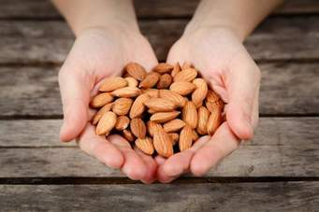
THE MOST HOLY PLACE
Inside the Ark of the Covenant
9 Proven Health Benefits of Almonds

Slide 71
1. Help Prevent Heart Disease and Heart Attacks
Two of the star chemical compounds of almonds nutrition are healthy monounsaturated fatty acids (the same kind of beneficial fat found in olive oil) and antioxidants that support heart health and prevent factors of cardiovascular disease.
Almonds specifically supply antioxidant flavonoids, plant-based compounds present in the skin of almonds that work with vitamin E to improve artery health and reduce inflammation.

Slide 72
1. Help Prevent Heart Disease and Heart Attacks
Almonds nutrition also holds key nutrients to heart health, including arginine, magnesium, copper, manganese, calcium and potassium. Studies show almonds have a consistent “bad” LDL cholesterol-lowering effect, especially in individuals with high cholesterol and diabetes.

Slide 73
1. Help Prevent Heart Disease and Heart Attacks
Almonds help prevent damage from forming within artery walls and protect against dangerous plaque build up. Almonds nutrition benefits also make them a great food to support healthy cholesterol and blood pressure levels, in addition to fighting weight gain and obesity — three of the biggest risk factors associated with heart attacks and stroke.
Notes:
(Point 1) As in the physical, so in the spiritual, God wants us to “…guard our hearts” – Proverbs 24: 20 My son, attend to my words; incline thine ear unto my sayings. 21 Let them not depart from thine eyes; keep them in the midst of thine heart. 22 For they are life unto those that find them, and health to all their flesh. 23 Keep thy heart with all diligence; for out of it are the issues of life. 24 Put away from thee a froward mouth, and perverse lips put far from thee. 27 Turn not to the right hand nor to the left: remove thy foot from evil.
Diligence - Constant and earnest effort to accomplish what is undertaken; persistent exertion of body or mind.

Slide 74
2. Support Healthy Brain Function
Almonds are often considered one of the best brain foods. Almonds nutrition is somewhat unique in that almonds contain riboflavin and L-carnitine, two key nutrients capable of positively affecting neurological activity and preventing cognitive decline. This is one reason why adults, especially the elderly, are encouraged to eat nuts several times per week — since they are associated with a reduction in the risk for inflammation that can cause brain disorders including dementia and Alzheimer’s disease.
Notes:
(Point 2) Almond is called the “King of nuts”! COGNITIVE – Thinking, Thought, Reasoning. That’s Frontal Lobe function! JRC - PA

Slide 75
3. Maintain Skin Health
Almonds are a great source of vitamin E and other antioxidants that nourish the skin and reduce signs of aging. Research finds that almonds nutrition contains high concentrations of catechin, epicatechin and flavonol antioxidants, including quercetin, kaempferol and isorhamnetin — compounds that fight skin cancer and damage by reversing oxidative stress from a poor diet, pollution and UV light exposure. Almonds’ healthy fats, plus their ability to improve circulation, also help keep skin hydrated and better able to heal wounds.

Slide 76
4. Help Control Blood Sugar Levels and Prevent Diabetes
Almonds’ rich supply of MUFAs helps slow the rate at which glucose (sugar) is released into the bloodstream. In addition to managing blood sugar and preventing insulin resistance (which can occur over time when the body becomes less reactive to insulin, the sugar-controlling hormone), almonds nutrition benefits include the ability to lower other common diabetes risks: unhealthy body weight, inflammation and high levels of oxidative stress.
Notes:
Personally, almonds for ne, is like a great “secret weapon”!! My favourite nut. My ATN story…Triumph! PRAISE THE LORD!!!

Slide 77
5. Help With Weight Loss and Prevent Overeating
Healthy fats and dietary fiber aid in weight loss because they help you feel full, which curbs overeating and unhealthy snacking. Although nuts are high in fat and calories, they prolong the feeling of satisfaction after you eat and keep your blood sugar more stable than low-fat meals do. Thus, you’re less likely to experience a roller-coaster of energy dips and food cravings. Almonds support a healthy metabolism. Also, people who frequently eat almonds and other nuts retain healthier body weights and lower rates of obesity over time compared to those who avoid nuts.
Notes:
The will and the power of choice must be exercised and the Jesus will help us to overcome any evil or injurious habits we might have.

Slide 78
6. Increase Nutrient Absorption
The body needs adequate amounts of fat in the diet in order to properly absorb “fat-soluble” nutrients, like vitamins A and D. Almonds are also considered one of the only nuts that help alkalize the digestive tract, reducing acid buildup and balancing the body’s pH. A healthy pH level is crucial for proper digestion, immunity and disease prevention. Additionally, the nutrients present in almonds may help regulate digestive enzymes that are involved in nutrient extraction, cholesterol synthesis and bile acid production.
Notes:
Immunity – The body is designed to heal itself (Barbara O'Neill, Walter Veith)

Slide 79
7. Increase Digestive Health
In addition to healthy fats and alkaline-forming molecules, almonds (especially the skin of almonds) contain probiotic components that help with digestion, detoxification and healthy bacterial growth within the gut flora — a key to actually utilizing nutrients from food and preventing nutrient deficiencies. Studies suggest that almonds and almond skins may lead to an improvement in the “intestinal microbiota profile,” meaning the intestine’s bacterial activities improve and promote numerous health benefits due to the presence of prebiotic properties, the precursors for probiotics.

Slide 80
8. Can Help Fight Cancer and Inflammation
Almonds contain gamma-tocopherol, a type of vitamin E that acts as a powerful antioxidant, fighting free radical damage and oxidative stress that are linked to cancer. Many studies find a link between nut consumption and cancer prevention, including a reduced risk for colon, prostate and breast cancers.

Slide 81
9. Help Maintain Dental and Bone Health
Almonds are a good source of trace minerals, including magnesium and phosphorus, which is a crucial nutrient for building and maintaining strong teeth and bones. Almonds nutrition benefits include the ability to help prevent tooth decay, fight cavities, lower the risk for bone fractures and fight osteoporosis.

Slide 82
The knowledge that man is to be a temple for God, a habitation for the revealing of His glory, should be the highest incentive to the care and development of our physical powers.
Fearfully and wonderfully has the Creator wrought in the human frame, and He bids us make it our study, understand its needs, and act our part in preserving it from harm and defilement. {MH 271.1}
Notes:
Rev. 14:6,7

Slide 83
THE MOST HOLY PLACE
Inside the Ark of the Covenant
Why did Aaron’s Rod Bud, Blossom and Bear Almonds?
Notes:
Rebellion!! Against God’s Prophet (Moses) and God’s (High) Priest (Aaron) – Antitypically: Rebellion against the Bible / Sanctuary Message / Jesus as High Priest in Heaven and the Prophet of the Remnant Church!! Let’s look at some of the scriptures!

Slide 84
NUMBERS 16
1 Now Korah, the son of Izhar, the son of Kohath, the son of Levi, and Dathan and Abiram, the sons of Eliab, and On, the son of Peleth, sons of Reuben, took men: 2 And they rose up before Moses, with certain of the children of Israel, two hundred and fifty princes of the assembly, famous in the congregation, men of renown: 3 And they gathered themselves together against Moses and against Aaron, and said unto them, Ye take too much upon you, seeing all the congregation are holy, every one of them, and the Lord is among them: wherefore then lift ye up yourselves above the congregation of the Lord?
Notes:
Who led the rebellion? Why did they rebel? / ¹⁰ And he hath brought thee near to him, and all thy brethren the sons of Levi with thee: and seek ye the priesthood also?

Slide 85
NUMBERS 16
12 And Moses sent to call Dathan and Abiram, the sons of Eliab: which said, We will not come up: 13 Is it a small thing that thou hast brought us up out of a land that floweth with milk and honey, to kill us in the wilderness, except thou make thyself altogether a prince over us? 14 Moreover thou hast not brought us into a land that floweth with milk and honey, or given us inheritance of fields and vineyards: wilt thou put out the eyes of these men? we will not come up.
Notes:
Rebellious – disobedient & stubborn, lie, and feisty! (ill-tempered; troublesome; difficult)

Slide 86
The Censer Test!
Numbers 16:
17 And take every man his censer, and put incense in them, and bring ye before the Lord every man his censer, two hundred and fifty censers; thou also, and Aaron, each of you his censer.
Notes:
So, you say you’re all holy…Let’s test it!! Careful whose company you keep; careful who you follow! Study for yourself! Seek to know the Lord personally for yourself! Be humble! Don’t be haughty like Pharaoh!! Do not reject / neglect / make of non-effect God’s words in the Bible and the Spirit of Prophecy! That’s very dangerous ground!!

Slide 87
Giving Up Faith in the Testimonies.--
One thing is certain: Those Seventh-day Adventists who take their stand under Satan's banner will first give up their faith in the warnings and reproofs contained in the Testimonies of God's Spirit. {3SM 84.3}
The call to great consecration and holier service is being made, and will continue to be made.--Letter 156, 1903. {3SM 84.4}
Notes:
Many reject the Sanctuary Message…Which is our central pillar!!

Slide 88
LDE Chapter 12 – The Shaking
Prosperity multiplies a mass of professors. Adversity purges them out of the church.--4T 89 (1876). {LDE 173.5} The time is not far distant when the test will come to every soul. The mark of the beast will be urged upon us. Those who have step by step yielded to worldly demands and conformed to worldly customs will not find it a hard matter to yield to the powers that be, rather than subject themselves to derision, insult, threatened imprisonment, and death. The contest is between the commandments of God and the commandments of men. In this time the gold will be separated from the dross in the church.--5T 81 (1882).
Notes:
Remember the golden pot? Jesus is asking us now – while there is still time, to buy of Him “gold tried in the fire”! (Revelation 3:18) LORD HELP US!!

Slide 89
Numbers 16:
35 And there came out a fire from the Lord, and consumed the two hundred and fifty men that offered incense.
Notes:
Matthew 3:11 (See also Luke 3:16) I indeed baptize you with water unto repentance. but he that cometh after me is mightier than I, whose shoes I am not worthy to bear: he shall baptize you with the Holy Ghost, and with fire:

Slide 90
THE MOST HOLY PLACE
THE TEN (10) COMMANDMENTS
Exodus 20
³ Thou shalt have no other gods before me.
⁴ Thou shalt not make unto thee any graven image, or any likeness of any thing that is in heaven above, or that is in the earth beneath, or that is in the water under the earth.
⁵ Thou shalt not bow down thyself to them, nor serve them: for I the Lord thy God am a jealous God, visiting the iniquity of the fathers upon the children unto the third and fourth generation of them that hate me;
⁶ And shewing mercy unto thousands of them that love me, and keep my commandments.
⁷ Thou shalt not take the name of the Lord thy God in vain; for the Lord will not hold him guiltless that taketh his name in vain.
⁸ Remember the sabbath day, to keep it holy.
⁹ Six days shalt thou labour, and do all thy work:
¹⁰ But the seventh day is the sabbath of the Lord thy God: in it thou shalt not do any work, thou, nor thy son, nor thy daughter, thy manservant, nor thy maidservant, nor thy cattle, nor thy stranger that is within thy gates:
¹¹ For in six days the Lord made heaven and earth, the sea, and all that in them is, and rested the seventh day: wherefore the Lord blessed the sabbath day, and hallowed it.
¹² Honour thy father and thy mother: that thy days may be long upon the land which the Lord thy God giveth thee.
¹³ Thou shalt not kill.
¹⁴ Thou shalt not commit adultery.
¹⁵ Thou shalt not steal.
¹⁶ Thou shalt not bear false witness against thy neighbour.
¹⁷ Thou shalt not covet thy neighbour's house, thou shalt not covet thy neighbour's wife, nor his manservant, nor his maidservant, nor his ox, nor his ass, nor any thing that is thy neighbour's.
FIRST 4
FINAL 6
Notes:
So, what is the fast we are to have today? The antitypical fast? Are the commandments still valid? The Decalogue covers every aspect of our lives.
1. Sin is the transgression of God’s law (1 John 3:4). 2. It is because of sin man fell and why Jesus had to die – Because the commandments cannot be changed or be removed, because it is the foundation of God’s throne! (Typified by the ark with the law inside / the Mercy Seat and Shekinah Glory in the MHP) 3. The Sabbath is key! That command tells us Who wrote the commandments! 4. Sin separated man from God. 5. God desires that all men be saved – that He and man be united in one again, back to man being the image of God! 6. So, the antitypical fast – is to reach the place where we have a permanent fast from sin!!! So – we – can – get - back – together with God!! So, we have to get rid of everything that is offensive to God. We have to be obedient in ALL things! HELP US LORD!!!

Slide 91
THE INVALUABLE GUIDE
Philippians 4:
7 And the peace of God, which passeth all understanding, shall keep your hearts and minds through Christ Jesus.
8 Finally, brethren, whatsoever things are true, whatsoever things are honest, whatsoever things are just, whatsoever things are pure, whatsoever things are lovely, whatsoever things are of good report; if there be any virtue, and if there be any praise, think on these things.
Notes:
The whosoever – John 3:16. The whatsoever – Philippians 4:8.

Slide 92
GOD WANTS US TO BE OBEDIENT – TO KEEP HIS COMMANDMENTS; THAT’S HOW WE SHOW OUR LOVE FOR HIM…OBEDIENCE!! AND WE ARE HIS FRIEND IF WE OBEY HIM IN ALL RESPECTS!
JOHN 14:15 & JOHN 15:14
Notes:
James 2:23 And the scripture was fulfilled which saith, Abraham believed God, and it was imputed unto him for righteousness: and he was called the Friend of God.
OVERCOMING SIN! 1 JOHN 3, etc. / REV. 12:17!!

Slide 93
1 CORINTHIANS 6:18 - 20
18 Flee fornication. Every sin that a man doeth is without the body; but he that committeth fornication sinneth against his own body. 19 What? know ye not that your body is the temple of the Holy Ghost which is in you, which ye have of God, and ye are not your own? 20 For ye are bought with a price: therefore glorify God in your body, and in your spirit, which are God's.

Slide 94
1 CORINTHIANS 6:18 - 20
Satan well knows that all whom he can lead to neglect prayer and the searching of the Scriptures, will be overcome by his attacks. Therefore he invents every possible device to engross the mind. {GC 519.2}
Notes:
Reading assignment – The Great Controversy Chapters 28 (The Investigative Judgment – 1888 OR Facing Life’s Record) AND Chapter 32 (Snares of Satan).

Slide 95
The role of diet!!!
Christ entered upon the test on the point of appetite, and for nearly six weeks resisted temptation in behalf of man. That long fast in the wilderness was to be a lesson to fallen man for all time. Christ was not overcome by the struggling against temptation. Christ has made it possible for every member of the human family to resist temptation. All who would live godly lives may overcome as Christ overcame, by the blood of the Lamb, and the word of their testimony. That long fast of the Saviour strengthened Him to endure. He gave evidence to man that He would begin the work of overcoming just where ruin began--on the point of appetite. {KC 166.1}
Notes:
Every device: Flesh food – Adventists eating even duck, turtle, etc. / Adventists drinking wine, green tea, coffee, etc. / Fast food / Processed foods and delicacies / Meat substitutes – Veggie this and veggie that…Even veggie bacon! etc.
Kress Collection, 1985 / Temperance 1949, Section 4

Slide 96
Role of fashion!!
A Snare to God's People
As we see the love of fashion and display among those who profess to believe present truth, we sadly ask, Will the people of God learn nothing from the history of the past? There are few who understand their own hearts. The vain and trifling lovers of fashion may claim to be followers of Christ; but their dress and conversation show what occupies the mind and engages the affections. Their lives betray their friendship for the world, and it claims them as its own. {MYP 354.3}
Notes:
MYP (1930) Chapter 21 – Simplicity in Dress

Slide 97
Role of fashion!!
A Snare to God's People
How can one that has ever tasted the love of Christ be satisfied with the frivolities of fashion? My heart is pained to see those who profess to be followers of the meek and lowly Saviour, so eagerly seeking to conform to the world's standard of dress. Notwithstanding their profession of godliness, they can hardly be distinguished from the unbeliever. They do not enjoy a religious life. Their time and means are devoted to the one object of dressing for display. {MYP 355.1}
Notes:
MYP (1930) Chapter 21 – Simplicity in Dress

Slide 98
Role of sports!!
" Satan has devised a multitude of ways in which to keep men from serving God. He has invented sports and games, into which men enter with such intensity that one would suppose a crown of life was to reward the winner. At the horse races and football matches, which are attended by thousands and thousands of people, lives for which Christ shed His blood are thrown away. What will become of the souls of the men and boys whose lives are thus extinguished? Will they be counted worthy of the redemption which Christ died to secure for them? {RH, September 10, 1901 par. 5}
Looking upon these God-dishonoring scenes, Christ asks, "What is a man profited, if he gain the whole world, and lose his own soul? or what shall a man give in exchange for his soul?"
Notes:
Will watching, participating in, winning in sports save us? Yet we do so while neglecting a study of the word of God and prayer!!

Slide 99
Role of music!!
Worship With a Bedlam of Noise
It is impossible to estimate too largely the work that the Lord will accomplish through His proposed vessels in carrying out His mind and purpose. The things you have described as taking place in Indiana, the Lord has shown me would take place just before the close of probation. Every uncouth thing will be demonstrated. There will be shouting, with drums, music, and dancing. The senses of rational beings will become so confused that they cannot be trusted to make right decisions. And this is called the moving of the Holy Spirit. {2SM 36.2}
Notes:
Are we near the close of probation?? What should we be doing??

Slide 100
Role of music!!
Worship With a Bedlam of Noise
The Holy Spirit never reveals itself in such methods, in such a bedlam of noise. This is an invention of Satan to cover up his ingenious methods for making of none effect the pure, sincere, elevating, ennobling, sanctifying truth for this time. Better never have the worship of God blended with music than to use musical instruments to do the work which last January was represented to me would be brought into our camp meetings. The truth for this time needs nothing of this kind in its work of converting souls. A bedlam of noise shocks the senses and perverts that which if conducted aright might be a blessing. The powers of satanic agencies blend with the din and noise, to have a carnival, and this is termed the Holy Spirit's working.
Notes:
What is that truth? The present truth!! THE THREE ANGELS’ MESSAGES!!!!

Slide 101
1 CORINTHIANS 6:18 - 20
There has ever been a class professing godliness, who, instead of following on to know the truth, make it their religion to seek some fault of character or error of faith in those with whom they do not agree. Such are Satan's right-hand helpers. Accusers of the brethren are not few, and they are always active when God is at work and His servants are rendering Him true homage.
Notes:
Reading assignment – The Great Controversy Chapters 28 (The Investigative Judgment – 1888 OR Facing Life’s Record) AND Chapter 32 (Snares of Satan).

Slide 102
1 CORINTHIANS 6:18 - 20
They will put a false coloring upon the words and acts of those who love and obey the truth. They will represent the most earnest, zealous, self-denying servants of Christ as deceived or deceivers. It is their work to misrepresent the motives of every true and noble deed, to circulate insinuations, and arouse suspicion in the minds of the inexperienced. In every conceivable manner they will seek to cause that which is pure and righteous to be regarded as foul and deceptive.{GC 519.2}
Notes:
Reading assignment – The Great Controversy Chapters 28 (The Investigative Judgment – 1888 OR Facing Life’s Record) AND Chapter 32 (Snares of Satan).

Slide 103
Present truth!!
2 Peter 1:12
Wherefore I will not be negligent to put you always in remembrance of these things, though ye know them, and be established in the present truth.
Notes:
In every era there is a present truth!!

Slide 104
Present truth is needed now!!
Satan is pressing in on every side, and unless we watch for him, and have our eyes open to his devices and snares, and have on the whole armor of God, the fiery darts of the wicked will hit us.
Notes:
Study Assignment – Ephesians 6:10 - 18.

Slide 105
CONSEQUENCES OF REJECTING PRESENT TRUTH
2 Thessalonians 2:
⁹ Even him, whose coming is after the working of Satan with all power and signs and lying wonders,
¹⁰ And with all deceivableness of unrighteousness in them that perish; because they received not the love of the truth, that they might be saved.
¹¹ And for this cause God shall send them strong delusion, that they should believe a lie:
¹² That they all might be damned who believed not the truth, but had pleasure in unrighteousness.
Notes:
2 Thessalonians 2:9 – 12
DELUSION - An erroneous belief that is held in the face of evidence to the contrary.

Slide 106
THE EFFECT OF Present truth!!!
There are many precious truths contained in the Word of God, but it is "present truth" that the flock needs now. I have seen the danger of the messengers running off from the important points of present truth, to dwell upon subjects that are not calculated to unite the flock and sanctify the soul.
Notes:
Reading Assignment - John chapter 17.
WHEN WE ARE UNITED AND SANCTIFIED – (AS THE PEOPLE WERE ON THE DAY OF ATONEMENT!) SATAN’S DOOM IS SECURED!!! HE – KNOWS – THAT…HENCE THE WAR ON THE REMNANT CHURCH!!!

Slide 107
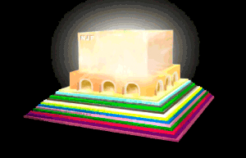
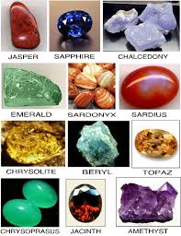
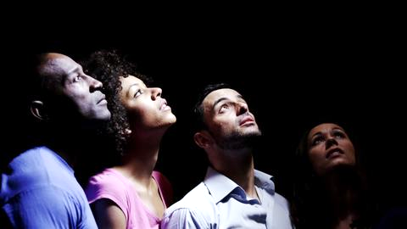
INSIDE? OR OUTSIDE?
14 Blessed are they that do his commandments, that they may have right to the tree of life, and may enter in through the gates into the city.
15 For without are dogs, and sorcerers, and whoremongers, and murderers, and idolaters, and whosoever loveth and maketh a lie.
Rev.
21:14
Notes:
It is not the keeping of the commandments that saves us – It is the merits of Christ’s blood…His sinless life and perfect sacrificial death and His bountiful provision of mercy and grace such that He clothes us with His robe of righteousness when we accept Him completely both as our Saviour and the Lord or Master of our lives!! BUT – It is because that we are saved and love Jesus why we keep His commandments, that is, we are obedient to Him / we become His friends – John 14:15 & John 15:14.
Revelation 22:14-15 // LORD HELP US PLEASE. PLEASE LORD.

