Slide 1
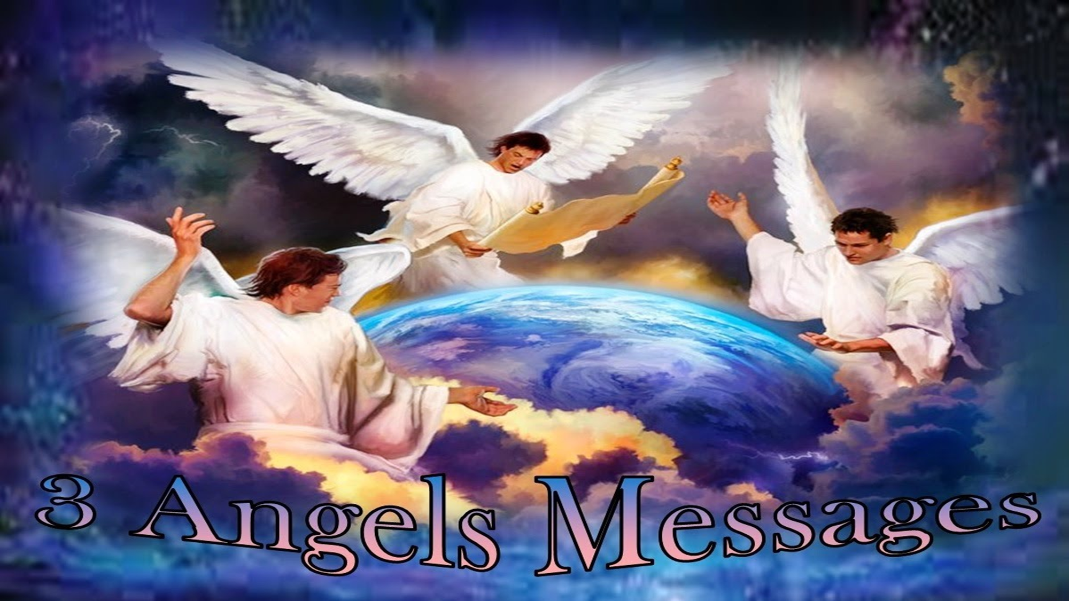

Slide 2
“PREPARING TO WALK ON STREETS OF GOLD”
Are YOU Preparing to Walk on Streets of Gold?

Slide 3
THE STREETS
Questions - Where are they? and when can we see them? Will I be able to walk on them? Do I need to do anything to get to walk on them?

Slide 4
The Context:
Revelation 21:
1 And I saw a new heaven and a new earth: for the first heaven and the first earth were passed away; and there was no more sea.
2 And I John saw the holy city, New Jerusalem, coming down from God out of heaven, prepared as a bride adorned for her husband.
Notes:
The streets are going to be somewhere; it’s part of a package; if you are going to be walking on the streets of gold – You will have access to and experience all the other things!

Slide 5
The Context:
Revelation 21:
3 And I heard a great voice out of heaven saying, Behold, the tabernacle of God is with men, and he will dwell with them, and they shall be his people, and God himself shall be with them, and be their God.
4 And God shall wipe away all tears from their eyes; and there shall be no more death, neither sorrow, nor crying, neither shall there be any more pain: for the former things are passed away.
Notes:
The streets are going to be somewhere; it’s part of a package; if you are going to be walking on the streets of gold – You will have access to and experience all the other things!

Slide 6
The Context:
Revelation 21:
7 He that overcometh shall inherit all things; and I will be his God, and he shall be my son.
Notes:
The streets are going to be somewhere; it’s part of a package; if you are going to be walking on the streets of gold – You will have access to and experience all the other things!

Slide 7
The Context:
Revelation 21:
12 And had a wall great and high, and had twelve gates, and at the gates twelve angels, and names written thereon, which are the names of the twelve tribes of the children of Israel:
16 And the city lieth foursquare, and the length is as large as the breadth: and he measured the city with the reed, twelve thousand furlongs. The length and the breadth and the height of it are equal.
Notes:
1500 miles long, 1500 miles wide and 1500 miles high!!!!!!!!!!!!

Slide 8
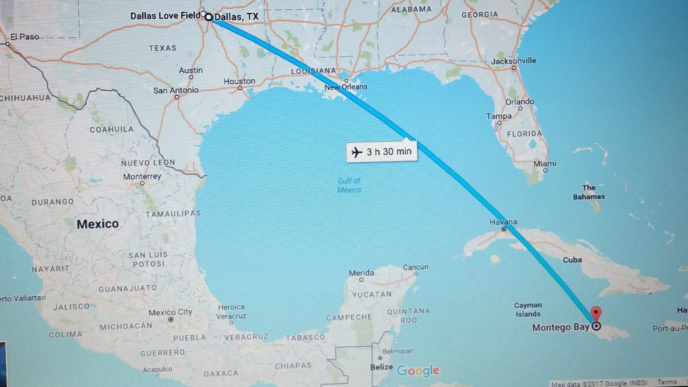
Notes:
1500 miles or 2,400 km is like travelling from Montego Bay to Dallas in Texas USA on an aeroplane travelling at about 686 mph – non stop; for 3½ hours.

Slide 9
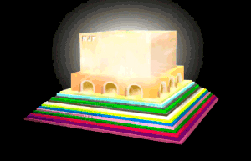
The Context:
Revelation 21:18
And the building of the wall of it was of jasper: and the city was pure gold, like unto clear glass.
Notes:
The streets are going to be somewhere; it’s part of a package; if you are going to be walking on the streets of gold – You will have access to and experience all the other things!

Slide 10

THE CITY
WALL AND GATES
TWELVE FOUNDATIONS
Notes:
City very disproportionate to the wall.

Slide 11
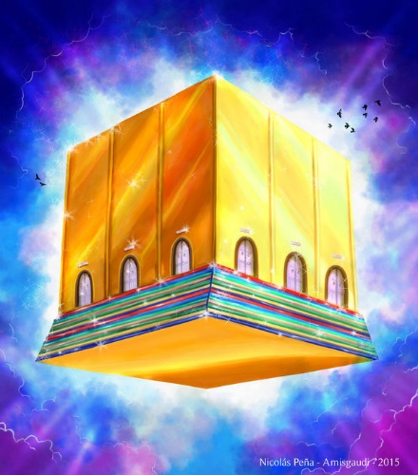

Slide 12
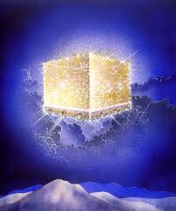

Slide 13
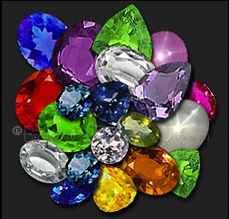
19 And the foundations of the wall of the city were garnished with all manner of precious stones. The first foundation was jasper; the second, sapphire; the third, a chalcedony; the fourth, an emerald;

Slide 14
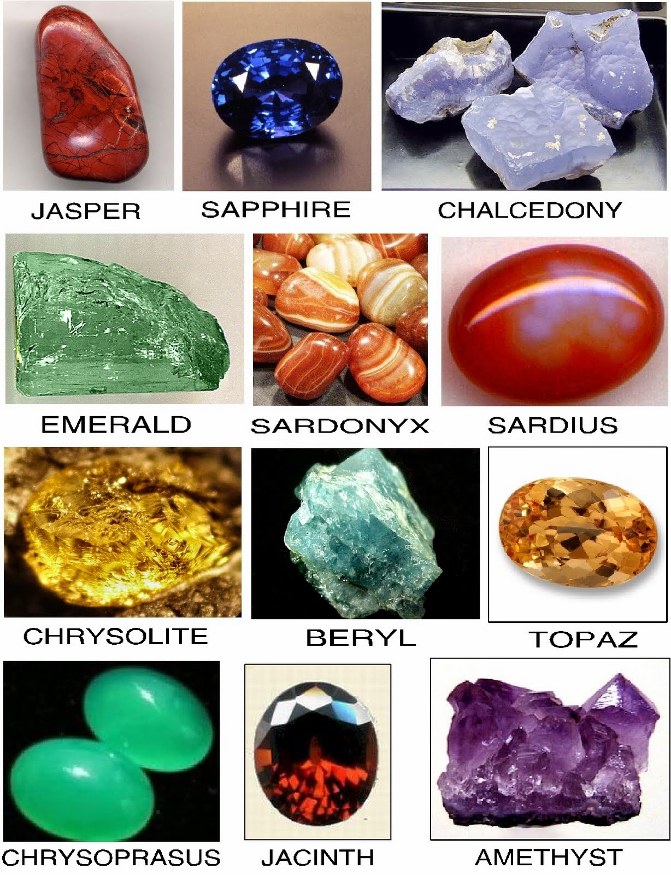
20 The fifth, sardonyx; the sixth, sardius; the seventh, chrysolyte; the eighth, beryl; the ninth, a topaz; the tenth, a chrysoprasus; the eleventh, a jacinth; the twelfth, an amethyst.

Slide 15
21 And the twelve gates were twelve pearls: every several gate was of one pearl: and the street of the city was pure gold, as it were transparent glass.
23 And the city had no need of the sun, neither of the moon, to shine in it: for the glory of God did lighten it, and the Lamb is the light thereof.

Slide 16
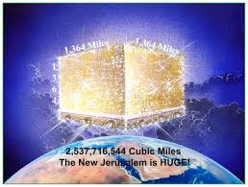

Slide 17
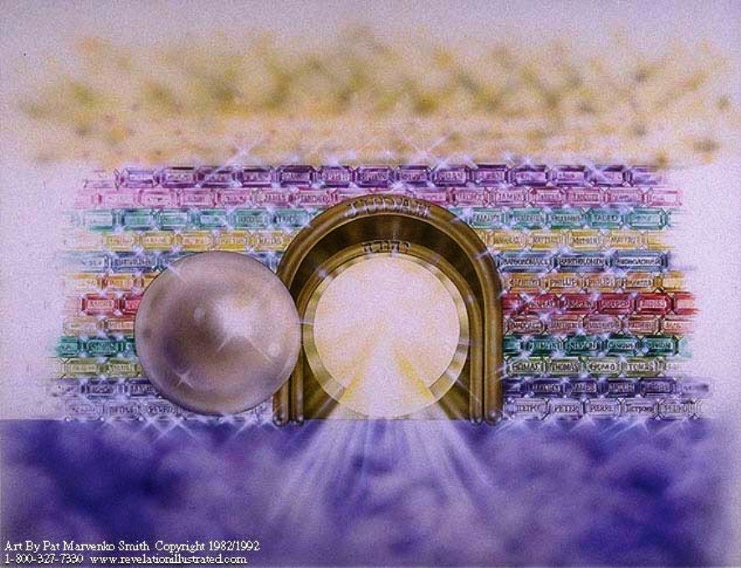
Name on Gate
21 And the twelve gates were twelve pearls: every several gate was of one pearl:
Gate of Pearl

Slide 18
Revelation 22:
And he shewed me a pure river of water of life, clear as crystal, proceeding out of the throne of God and of the Lamb.
2 In the midst of the street of it, and on either side of the river, was there the tree of life, which bare twelve manner of fruits, and yielded her fruit every month: and the leaves of the tree were for the healing of the nations.
Notes:
Where was this tree of life before? (Ask a child to answer; give a gift) // What fruits do you think might be on the tree?

Slide 19
4 And they shall see his face; and his name shall be in their foreheads.
5 And there shall be no night there; and they need no candle, neither light of the sun; for the Lord God giveth them light: and they shall reign for ever and ever.
Notes:
REMEMBER THIS: “…his name shall be in their foreheads.”

Slide 20
So, will we be able to walk on the streets of gold? (And experience everything else the Bible talks about?)
Yes!!! But there are conditions that apply!
1. Rev 21: 27 And there shall in no wise enter into it any thing that defileth, neither whatsoever worketh abomination, or maketh a lie: but they which are written in the Lamb's book of life.
Notes:
Notes: How do we get our names written in the Lamb’s Book of Life? BY ACCEPTING JESUS CHRIST AS OUR LORD AND SAVIOUR!!

Slide 21
2. Revelation 22:
14 Blessed are they that do his commandments, that they may have right to the tree of life, and may enter in through the gates into the city. (And where are the streets of gold?)
15 For without are dogs, and sorcerers, and whoremongers, and murderers, and idolaters, and whosoever loveth and maketh a lie.
Notes:
Notes:
In Phil. 3:2 and Rev 22:15, dogs are coupled with evil-workers, sorcerers, etc. / Phil. 3:2 Beware of dogs, beware of evil workers, beware of the concision. References to the dog, both in the Old Testament and in the New Testament, are usually of a contemptuous character. A dog, and especially a dead dog, is used as a figure of insignificance.

Slide 22
Serious Preparation is needed if we’re going to Walk on those Streets of Gold:

Slide 23
FOUNDATION:
Romans 3:23 (KJV) For all have sinned, and come short of the glory of God;
Romans 6:23 For the wages of sin is death; but the gift of God is eternal life through Jesus Christ our Lord.
John 3: 16 For God so loved the world, that he gave his only begotten Son, that whosoever believeth in him should not perish, but have everlasting life. 17 For God sent not his Son into the world to condemn the world; but that the world through him might be saved.

Slide 24
FOUNDATION:
WHAT IS SIN?
Whosoever committeth sin transgresseth also the law: for sin is the transgression of the law.
1 John 3:4
Notes:
Since sin is THE PROBLEM – Because it causes death…What is sin?

Slide 25
NECESSARY ACTIONS:
Acknowledge that you are a sinner:
Luke 18:13 And the publican, standing afar off, would not lift up so much as his eyes unto heaven, but smote upon his breast, saying, God be merciful to me a sinner.
Confess your sins to God:
1 John 1:9 If we confess our sins, he is faithful and just to forgive us our sins, and to cleanse us from all unrighteousness.

Slide 26
Repent of your sins:
Acts 17:30 And the times of this ignorance God winked at; but now commandeth all men every where to repent: 31 Because he hath appointed a day, in the which he will judge the world in righteousness by that man whom he hath ordained; whereof he hath given assurance unto all men, in that he hath raised him from the dead.

Slide 28
Accept Jesus as Your Saviour:
Isaiah 43:11 I, even I, am the Lord; and beside me there is no saviour.
Luke 2:11 For unto you is born this day in the city of David a Saviour, which is Christ the Lord.
John 4:42 And said unto the woman, Now we believe, not because of thy saying: for we have heard him ourselves, and know that this is indeed the Christ, the Saviour of the world.

Slide 29
Accept Jesus as Lord and Master of Your Life:
John 13:14 If I then, your Lord and Master, have washed your feet; ye also ought to wash one another's feet.
1 Timothy 1:1 Paul, an apostle of Jesus Christ by the commandment of God our Saviour, and Lord Jesus Christ, which is our hope;

Slide 30
So, When Should You Accept Jesus as Lord and Saviour of Your Life?
Hebrews 3:15 While it is said, To day if ye will hear his voice, harden not your hearts, as in the provocation.
Hebrews 4:7 Again, he limiteth a certain day, saying in David, To day, after so long a time; as it is said, To day if ye will hear his voice, harden not your hearts.

Slide 31
Keep God’s Commandments:
John 14:15 If ye love me, keep my commandments.
John 15:14 Ye are my friends, if ye do whatsoever I command you.
Revelation 22: 14 Blessed are they that do his commandments, that they may have right to the tree of life, and may enter in through the gates into the city.

Slide 32
What Commandments?
Why Should I Keep Them?
The Ten Commandments
Have no other gods before the God of Heaven.
Don’t make and worship graven images.
Don’t take God’s name in vain.
Remember the seventh-day Sabbath and keep it holy.
Honour your father and mother that you may live long.
Do not kill / commit murder.
Do not commit adultery / fornicate.
Do not steal.
Do not bear false witness / tell lie.
Do not covet your neighbours house, wife … or anything that is your neighbour’s.
Exodus 20:1 & 2
And God spake all these words, saying,
2. I am the Lord thy God, which have brought thee out of the land of Egypt, out of the house of bondage.
Notes:
Exodus 20:1 – 17.

Slide 33
Matthew 24:42 Watch therefore: for ye know not what hour your Lord doth come.
BEFORE JESUS COMES and we get to walk on streets of gold:
Acts 14:22 Confirming the souls of the disciples, and exhorting them to continue in the faith, and that we must through much tribulation enter into the kingdom of God.
Psalm 37:39 But the salvation of the righteous is of the Lord: he is their strength in the time of trouble.

Slide 34
A Time of Trouble Such as Never Was!!
Daniel 12:1 And at that time shall Michael stand up, the great prince which standeth for the children of thy people: and there shall be a time of trouble, such as never was since there was a nation even to that same time: and at that time thy people shall be delivered, every one that shall be found written in the book.
Notes:
What book?

Slide 35
THE MARK OF THE BEAST
WHAT WILL BE THAT “TIME OF TROUBLE”?
Revelation 13:
11 And I beheld another beast coming up out of the earth; and he had two horns like a lamb, and he spake as a dragon.
14 And deceiveth them that dwell on the earth by the means of those miracles which he had power to do in the sight of the beast; saying to them that dwell on the earth, that they should make an image to the beast, which had the wound by a sword, and did live.
15 And he had power to give life unto the image of the beast, that the image of the beast should both speak, and cause that as many as would not worship the image of the beast should be killed.

Slide 36
THE MARK OF THE BEAST
WHAT WILL BE THAT “TIME OF TROUBLE”?
16 And he causeth all, both small and great, rich and poor, free and bond, to receive a mark in their right hand, or in their foreheads:
17 And that no man might buy or sell, save he that had the mark, or the name of the beast, or the number of his name.
Where did we see that before??
Revelation 22:4 And they shall see his face; and his name shall be in their foreheads.
Notes:
Where did we see that before? Revelation 22:4 And they shall see his face; and his name shall be in their foreheads.
The battle is for the mind and who you will worship – God or satan?

Slide 37
Yes friend the Mark of the Beast Crisis is going to take place soon. I'm telling you this not to scare you but to alert you that you need to start to prepare now. Yes, before Jesus comes there will be a terrible time of trouble; it will be worse than any other time of trouble the world has ever seen.
Yes friends, before Jesus comes to take to Heaven those who love, obey and trust Him and serve Him in spirit and in truth so that we can walk on those golden streets: this - crisis – must – come! I must tell you the truth!
This gives us all the more reason to prepare and serve Jesus now – Because we have only a short time left.
Only Jesus can help us through the Mark of the Beast Crisis – So we have to accept Him as our Lord and Saviour and get to know Him and develop a relationship with him NOW. Moreover, no one knows when they will die, so act now.
Jesus is calling you NOW my friend: What is your answer to Him?
Notes:
The Saviour is waiting to enter your heart. Hymn 289. End with appeal and then appropriate literature distribution. PRAISE THE LORD!!!

