Slide 1
Antitypical Dark Ages – (?)
Martyrdom at the end…(?)

Slide 2
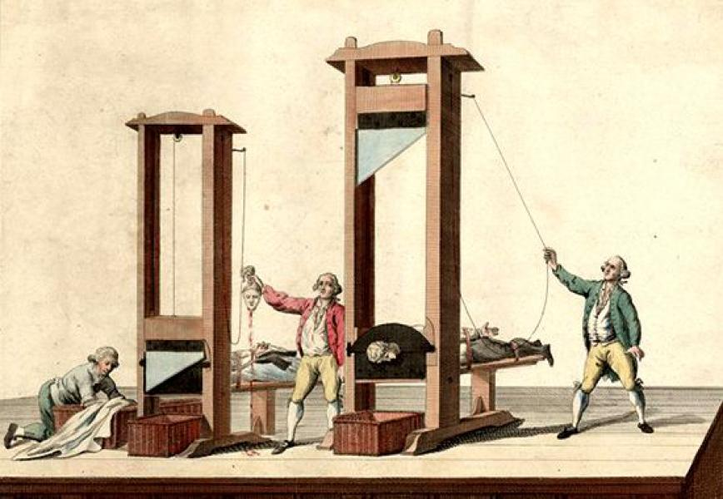
The antitype (which is soon to happen) will be much worse than what happened back then. Am I ready?
Notes:
If there is time a quick synopsis of the Mark of the Beast killing deluge that will characterise the final crisis could be presented. French Revolution – Beast from the bottomless pit!! │Types – Antitypes to Ultimate Antitype: [1] Early Church Persecution – Death of the Apostles, etc, [2] Roman persecution – Nero etc. / Diocletian 303 – 313 A.D. [3] Dark Ages 538 – 1798 /\ French Revolution – 1789 – 91-2

Slide 3
JESUS SPOKE
4 And Jesus answered and said unto them, Take heed that no man deceive you.
5 For many shall come in my name, saying, I am Christ; and shall deceive many.
6 And ye shall hear of wars and rumours of wars: see that ye be not troubled: for all these things must come to pass, but the end is not yet.
MATTHEW 24
Notes:
Kill God’s people they did in the Dark Ages – But they were not “hated of all nations” (how is that fact proven?)
Wars: Many, but only two (2) were categorized as “World War” = WW1 (1914 – 18 Kaiser Wilhelm OC “The Kaiser” = Germany) & WW2 (1939 – 1945 {the USA entered the war in 1943} Hitler AC “The Fuhrer”)

Slide 4
JESUS SPOKE
7 For nation shall rise against nation, and kingdom against kingdom: and there shall be famines, and pestilences, and earthquakes, in divers places.
8 All these are the beginning of sorrows.
9 Then shall they deliver you up to be afflicted, and shall kill you: and ye shall be hated of all nations for my name's sake.
MATTHEW 24
Notes:
Kill God’s people they did in the Dark Ages – But they were not “hated of all nations” (how is that fact proven?)
Wars: Many, but only two (2) were categorized as “World War” = WW1 (1914 – 18 Kaiser Wilhelm OC “The Kaiser” = Germany) & WW2 (1939 – 1945 {the USA entered the war in 1943} Hitler AC “The Fuhrer”)

Slide 5
REVELATION 6: Jesus Testifies…
9 And when he had opened the fifth seal, I saw under the altar the souls of them that were slain for the word of God, and for the testimony which they held:
10 And they cried with a loud voice, saying, How long, O Lord, holy and true, dost thou not judge and avenge our blood on them that dwell on the earth?
11 And white robes were given unto every one of them; and it was said unto them, that they should rest yet for a little season, until their fellowservants also and their brethren, that should be killed as they were, should be fulfilled.
Notes:
FLASH FORWARD: Rev 16:6 For they have shed the blood of saints and prophets, and thou hast given them blood to drink; for they are worthy.

Slide 6
REVELATION 12:11
11 And they overcame him by the blood of the Lamb, and by the word of their testimony; and they loved not their lives unto the death.
MATTHEW 4:4
Notes:
Rev 12:10 And I heard a loud voice saying in heaven, Now is come salvation, and strength, and the kingdom of our God, and the power of his Christ: for the accuser of our brethren is cast down, which accused them before our God day and night.
Rev 12:12 Therefore rejoice, ye heavens, and ye that dwell in them. Woe to the inhabiters of the earth and of the sea! for the devil is come down unto you, having great wrath, because he knoweth that he hath but a short time. │BLOOD G129 “aima” - specifically (the atoning blood of Christ); │Revisit REVELATION 6:9 – 11: WHY were they slain? V. 9: “slain for the word of God, and for the testimony which they held:” Is there any similarity here? │What was the issue in the dark ages? Concerning dogmas and beliefs? Weren’t people killed because they believed and practised TRUTH – which was opposite to what the “powers that be” / THE PAPACY taught? What were those who were obedient to the truth of the Word of God called (by what specific word)? What did that word mean? Were these persons “OVERCOMERS”? “white robes were given unto every one of them” (victory / atoned for / put away sin / obedient – pure character) │ Rev 3:18 / Dan 7:9 / Rev 15:6 Rev 7:9, 13, 14 + 19:8 - And to her was granted that she should be arrayed in fine linen, clean and white: for the fine linen is the righteousness of saints.

Slide 7
REV 12:17
17 And the dragon was wroth with the woman, and went to make war with the remnant of her seed, which keep the commandments of God, and have the testimony of Jesus Christ.
Notes:
Rev 19:9 And he saith unto me, Write, Blessed are they which are called unto the marriage supper of the Lamb. And he saith unto me, These are the true sayings of God.
Rev 19:10 And I fell at his feet to worship him. And he said unto me, See thou do it not: I am thy fellowservant, and of thy brethren that have the testimony of Jesus: worship God: for the testimony of Jesus is the spirit of prophecy. War – WHAT HAPPENS IN WARS?

Slide 8
REVELATION 13
7 And it was given unto him to make war with the saints, and to overcome them: and power was given him over all kindreds, and tongues, and nations.
¹² And he exerciseth all the power of the first beast before him, and causeth the earth and them which dwell therein to worship the first beast, whose deadly wound was healed.
¹⁵ And he had power to give life unto the image of the beast, that the image of the beast should both speak, and cause that as many as would not worship the image of the beast should be killed.
Notes:
THE DOMINIONISTS WILL FINALLY GET THEIR WISH – AND WILL CARRY OUT SATAN’S AGENDA / PLAN TO THE LETTER!!
VERSES: 4, 8, 12 and 15 lets us know the crisis will be about whom we worship / who has the authority and should be worshiped. THE NATTLE OF ARMAGEDDON (Gog and Magog vs. JESUS) Who would be Gog and who / which system / will be Magog in the Final Crisis?

Slide 9
REVELATION 13:
7 And it was given unto him to make war with the saints, and to overcome them: and power was given him over all kindreds, and tongues, and nations.
8 And all that dwell upon the earth shall worship him, whose names are not written in the book of life of the Lamb slain from the foundation of the world.
Notes:
How do names get written in the book of life of the Lamb?

Slide 10
REVELATION 14:9-12
9 And the third angel followed them, saying with a loud voice, If any man worship the beast and his image, and receive his mark in his forehead, or in his hand,
10 The same shall drink of the wine of the wrath of God, which is poured out without mixture into the cup of his indignation; and he shall be tormented with fire and brimstone in the presence of the holy angels, and in the presence of the Lamb:
Notes:
c.f. Rev 14:18 And another angel came out from the altar, which had power over fire; and cried with a loud cry to him that had the sharp sickle, saying, Thrust in thy sharp sickle, and gather the clusters of the vine of the earth; for her grapes are fully ripe.
Rev 14:19 And the angel thrust in his sickle into the earth, and gathered the vine of the earth, and cast it into the great winepress of the wrath of God. (What might that winepress be? The seven (7) last plagues?) Rev 15 & 16 seems to support that idea!
Rev 14:20 And the winepress was trodden without the city, and blood came out of the winepress, even unto the horse bridles, by the space of a thousand and six hundred furlongs.

Slide 11
REVELATION 14:9-12 (cont’d.)
11 And the smoke of their torment ascendeth up for ever and ever: and they have no rest day nor night, who worship the beast and his image, and whosoever receiveth the mark of his name.
12 Here is the patience of the saints: here are they that keep the commandments of God, and the faith of Jesus.
Notes:
Note: The saints: …keep the commandments of God, and the faith of Jesus. IOW – they do not receive the Mark of the Beast!! Galatians 2:16 (AA 387.1); + 2:20; 3 SM 172.3. NOTE: There is a stark contrast between verses 9 – 11 c.f. verse 12 = Two different categories… │The contest is between the commandments of God and the commandments of men. In this time the gold will be separated from the dross in the church. 5T 81.1 │The beast’s name is blasphemy (Rev 13:1) and his mark (of authority) is the 1st day of the week – Sunday – sabbath.

Slide 12
REVELATION 14:
12 Here is the patience of the saints: here are they that keep the commandments of God, and the faith of Jesus.
13 And I heard a voice from heaven saying unto me, Write, Blessed are the dead which die in the Lord from *henceforth: Yea, saith the Spirit, that they may rest from their labours; and their works do follow them. (*”From now on” / “From this time” / “Starting from this time”)
PATIENT, FAITHFUL, OBEDIENT SAINTS!
PATIENT, FAITHFUL, OBEDIENT SAINTS – ❺ MANY WILL DIE
Notes:
❶ Does the word “labours” here have any significance with respect to the topic? (See next couple slides.) ❺ Many who will die will be those that comprise the harvest that resulted from seed sown just before and during the Loud Cry! (OR, “the extended Loud Cry”)

Slide 13
Significance and importance of ONE word (Matthew 4:4)
❶ Does the word “labours” here have any significance with respect to the topic? G2873 “kopos” From G2875; a cut, (inter alia) that is, (by analogy) toil (as reducing the strength), literally or figuratively; by implication pains: - labour, + trouble, weariness. (KJV = 9 times)│❷ G2875 “koptō” A primary verb; (inter alia) to “chop”; specifically to beat the breast in grief: - cut down, lament, mourn, (be-) wail. (KJV = 8 times)

Slide 14
Significance and importance of ONE word (Matthew 4:4)
│#❷ says to ❸ Compare the base of G5114 “tomoteros̄” = Compound of a derivative of the primary word temnō (to cut; more comprehensive or decisive than G2875, as if by a single stroke (sic); whereas that (i.e. G2875 = kopto) implies repeated blows, like hacking); (tomoteros is) more keen: - sharper. (Total KJV occurrences = 1)
Notes:
I was absolutely blown away with amazement and great delight on this discovery!! Took me quite a while to let it soak in… I was beside myself. Decidedly the most marvellous new revelation I have received in the WORD and, on this subject!

Slide 15
The antitype (which is soon to happen) will be much worse than what happened in “The Dark Ages”. Am I ready?
Notes:
IS THERE ANY EXAMPLE OF ANY TYPE EXCEEDING / IS / WAS GREATER THAN THE ANTITYPE?...? HOW MANY CUTS DO YOU THINK THESE CONTRAPTIONS / MACHINES NEED TO SEVER A HEAD FROM THE BODY?

Slide 16
Significance and importance of ONE word (Matthew 4:4)
❹ SO, WHAT DOES THE WORD “LABOURS” HAVE TO DO WITH THE TOPIC? WHAT DO YOU THINK IT’S TALKING ABOUT? │”THEIR WORKS DO FOLLOW THEM” AS IN THE DARK AGES, THOSE WHO DIE AT THIS (SPECIFIC) TIME WILL WITNESS TO OTHERS WITH THEIR BLOOD…THIS MUST NOT BE CONFUSED WITH THE TIME OF THE CLOSE OF PROBATION… WHEN PROBATION CLOSES NO ONE WHO IS RIGHTEOUS WILL DIE… RATHER, IT’S PUNISHMENT TIME FOR THE WICKED i.e. FOR THOSE WHO RECEIVED THE MOB i.e. THOSE WHO REJECTED GOD’S FINAL. WARNING MESSAGE OF LOVE (vv. 9 – 11)!
Notes:
MOB = MARK OF THE BEAST.

Slide 17
Significance and importance of ONE word (Matthew 4:4)
JESUS COMES AFTER THE BLOODSHED AND, AFTER THE PLAGUES ON THOSE WHO SHED THE BLOOD i.e. THOSE WHO RECEIVED THE MARK OF THE BEAST!! │Hence: Rev 16:4 And the third angel poured out his vial upon the rivers and fountains of waters; and they became blood. Rev 16:5 And I heard the angel of the waters say, Thou art righteous, O Lord, which art, and wast, and shalt be, because thou hast judged thus. Rev 16:6 For they have shed the blood of saints and prophets, and thou hast given them blood to drink; for they are worthy (deserving / due reward). Q. WOULD THIS VERSE BE IN THE BIBLE IF NO ONE, IOW, NO SAINTS WERE KILLED?
Notes:
IOW = In Other Words. │WHICH SAINTS AND PROPHETS IS VERSE 6 SPEAKING OF?

Slide 18
AA (1911) CHAPTER 52: STEADFAST UNTO THE END
In the providence of God, Peter was permitted to close his ministry in Rome, where his imprisonment was ordered by the emperor Nero about the time of Paul's final arrest. Thus the two veteran apostles, who for many years had been widely separated in their labors, were to bear their last witness for Christ in the world's metropolis, and upon its soil to shed their blood as the seed of a vast harvest of saints and martyrs. AA 537.1
Notes:
Type to Type then to Time of the End Antitype. │WILL IT BE ANY DIFFERENT IN THE ANTITYPE?

Slide 19
GREAT CONTROVERSY (1888):
CHAPTER IV – THE WALDENSES
The work of these missionaries began in the plains and valleys at the foot of their own mountains, but it extended far beyond these limits. With naked feet and in garments coarse and travel-stained as were those of their Master, they passed through great cities, and penetrated to distant lands. Everywhere they scattered the precious seed. Churches sprung up in their path, and the blood of martyrs witnessed for the truth. The day of God will reveal a rich harvest of souls garnered by the labors of these faithful men. GC88 71.2

Slide 20
THE GREAT CONTROVERSY (1888): CHAPTER XXXIX: “The Time of Trouble”
The eye of God, looking down the ages, was fixed upon the crisis which his people are to meet, when earthly powers shall be arrayed against them. Like the captive exile, they will be in fear of death by starvation or by violence. But the Holy One who divided the Red Sea before Israel, will manifest his mighty power and turn their captivity. “They shall be mine, saith the Lord of hosts, in that day when I make up my jewels; and I will spare them, as a man spareth his own son that serveth him.” [Malachi 3:17.] If the blood of Christ's faithful witnesses were shed at this time, it would not, like the blood of the martyrs, be as seed sown to yield a harvest for God. Their fidelity would not be a testimony to convince others of the truth; for the obdurate heart has beaten back the waves of mercy until they return no more.
Notes:
MIND MADE UP VIA CHOICE AND FORCED AND HARDENED AND SECURED FOR SATAN! Rev 14:10 _”without mixture” G194 akratos = undiluted (no mercy?). IOW no one (else) would be convinced to turn to God if they should die! Hmm mm! Help – us – Lord! “in fear of death by starvation or by violence” Why? Death decree!

Slide 21
Cont’d.
If the righteous were now left to fall a prey to their enemies it would be a triumph for the prince of darkness. Says the psalmist, “In the time of trouble he shall hide me in his pavilion; in the secret of his tabernacle shall he hide me.” [Psalm 27:5.] Christ has spoken: “Come, my people, enter thou into thy chambers, and shut thy doors about thee; hide thyself as it were for a little moment, until the indignation be overpast. For, behold, the Lord cometh out of his place to punish the inhabitants of the earth for their iniquity.” [Isaiah 26:20, 21.] Glorious will be the deliverance of those who have patiently waited for his coming, and whose names are written in the book of life. {GC88 634.1}
Notes:
Quote on an angel hiding the saints in the final part of the battle…?

Slide 22
REVELATION 14:
The Harvest of the Earth:
Rev 14:14 And I looked, and behold a white cloud, and upon the cloud one sat like unto the Son of man, having on his head a golden crown, and in his hand a sharp sickle.
Rev 14:15 And another angel came out of the temple, crying with a loud voice to him that sat on the cloud, Thrust in thy sickle, and reap: for the time is come for thee to reap; for the harvest of the earth is ripe.
Rev 14:16 And he that sat on the cloud thrust in his sickle on the earth; and the earth was reaped.
Notes:
DIRECT FULFILLMENT OF JESUS’ PROPHECY: THE THREE ANGELS’ MESSAGES = THE GOSPEL OF THE KINGDOM / THE GOOD NEWS OF JESUS’ KINGDOM! Mat 24:13 But he that shall endure unto the end, the same shall be saved. Mat 24:14 And this gospel of the kingdom shall be preached in all the world for a witness unto all nations; and then shall the end come. │Mat 13:30 Let both grow together until the harvest: and in the time of harvest I will say to the reapers, Gather ye together first the tares, and bind them in bundles to burn them: but gather the wheat into my barn. (Interesting / sounds like Rev. turns it the other way around(?) Hmm. │READ VERSES 17 -

Slide 23
Revelation 15:2
And I saw as it were a sea of glass mingled with fire: and them that had gotten the victory over the beast, and over his image, and over his mark, and over the number of his name, stand on the sea of glass, having the harps of God.
Notes:
DELINEATE AND OR CLARIFY THE FIVE (5) AREAS OF VICTORY: BEAST – IMAGE – MARK – NUMBER - NAME │Revelation 13:1, etc. NAMES: VICARIUS FILII DEI / BASILEUS / ROMIITI / LATEINOS /

Slide 24
REVELATION 20:4
And I saw thrones, and they sat upon them, and judgment was given unto them: and I saw the souls of them that were beheaded for the witness of Jesus, and for the word of God, and which had not worshipped the beast, neither his image, neither had received his mark upon their foreheads, or in their hands; and they lived and reigned with Christ a thousand years.
Notes:
beheaded = KILLED AS THEY WERE! │ ELUCIDATE! SO MUCH INFORMATION IS PACKED INTO THIS VERSE!! WOW! THIS IS SO ABSOLUTELY CLEAR – IT’S NOT TALKING ABOUT ANY OTHER TIME THAN THE FINAL CRISIS / BATTLE – THE MARK OF THE BEAST…

Slide 25
The Saints Will Not Lose Their Lives
God would not suffer the wicked to destroy those who were expecting translation, and who would not bow to the decree of the beast or receive his mark. I saw that if the wicked were permitted to slay the saints, Satan and all his evil host, and all who hate God, would be gratified. And oh, what a triumph it would be for his satanic majesty, to have power, in the last closing struggle, over those who had so long waited to behold Him whom they loved! Those who have mocked at the idea of the saints' going up will witness the care of God for His people, and behold their glorious deliverance.--EW 284 (1858). {LDE 263.3}
Notes:
NOTE VERY WELL: THIS IS OBVIOUSLY SPEAKING OF THE SAINTS THAT ARE LEFT / HAD NOT BEEN KILLED IN THE MASSIVE DELUGE / BEHEADING / THOSE WHO WOULD BE IN THE “Time of Jacob’s Trouble” – the 144,000 WHO WOULD HAVE A DEATH SENTENCE OVER THEIR HEADS AT THAT TIME – THEY HAVE STOOD THE TEST AND NOT SINNED WHEN JESUS WAS NO LONGER MEDIATING IN THE SANCTUARY / THE SEVEN LAST PLAGUES ARE FALLING / THEY HAVE VINDICATED GOD’S CHARACTER!!! THEY CANNOT BE KILLED BY THE ENEMY BECAUSE THEY WILL BE THE ONES WHO ARE “ALIVE AND REMAIN”!!! THIS COMPLETELY SYNCHRONIZES WITH THE QUOTE FROM THE PROPHET!

Slide 26
The Saints Will Not Lose Their Lives (cont’d.)
The people of God will not be free from suffering; but while persecuted and distressed, while they endure privation, and suffer for want of food, they will not be left to perish.--GC 629 (1911). {LDE 264.1}
If the blood of Christ's faithful witnesses were shed at this time, it would not, like the blood of *the martyrs, be as seed sown to yield a harvest for God.--GC 634 (1911). {LDE 264.2}
Notes:
“this time” – Special time = the “Time of Jacob’s Trouble” – the clarification is right in the quote itself! /\ THIS IS SAYING THAT THOSE WHO HAD DIED IN THE CONFLICT – MARTYRS FOR CHRIST JESUS! – THEIR SHED BLOOD WAS AS SEED “To yield a harvest for God”!! /\ IF ANY SAINT WOULD DIE AT THIS TIME THERE’D BE NO HARVEST – WHY?? PROBATION - HAD – CLOSED! / EVERYONE HAD MADE THEIR CHOICE FOR OR AGAINST GOD (the “for God” includes the ones martyred!) │ *What martyrs could the Prophet be speaking of – other than those who were beheaded for the Word of God and for the testimony they held, as mentioned in Revelation 20:4? TRULY, THEY HAD BEEN FAITHFUL AND TRUE WITNESSES! Despite the opposition of the entire world! │ TYPE – MEETS – ANTITYPE – PERFECTLY – IN – THIS – SCENARIO!! In the typical scenario many escaped with their lives! Taken out of the reach of the hands of the serpent!

Slide 27
SPEAKING OF THE WALDENSES
The work of these missionaries began in the plains and valleys at the foot of their own mountains, but it extended far beyond these limits. With naked feet and in garments coarse and travel-stained as were those of their Master, they passed through great cities, and penetrated to distant lands. Everywhere they scattered the precious seed. Churches sprung up in their path, and the blood of martyrs witnessed for the truth. The day of God will reveal a rich harvest of souls garnered by the labors of these faithful men. Veiled and silent, the Word of God was making its way through Christendom, and meeting a glad reception in the homes and hearts of men. {GC88 71.2}

Slide 28
The Righteous Have No Concealed Wrongs to Reveal
In the time of trouble, if the people of God had unconfessed sins to appear before them while tortured with fear and anguish, they would be overwhelmed; despair would cut off their faith, and they could not have confidence to plead with God for deliverance. But while they have a deep sense of their unworthiness, they have no concealed wrongs to reveal. Their sins have gone beforehand to judgment, and have been blotted out; and they cannot bring them to remembrance.--GC 620 (1911). {LDE 263.1}
Notes:
They had entered the Most Holy Place with Jesus, done the corresponding work that was necessary and put on the white robe of Christ’s righteousness!!!!!!!
What does that sound like? Answer: The time of Jacob’s struggle. CLOSE OF PROBATION / 7 LAST PLAGUES…

Slide 29
The Righteous Have No Concealed Wrongs to Reveal cont’d.
God's people . . . will have a deep sense of their shortcomings, and as they review their lives their hopes will sink. But remembering the greatness of God's mercy, and their own sincere repentance, they will plead His promises made through Christ to helpless, repenting sinners. Their faith will not fail because their prayers are not immediately answered. They will lay hold of the strength of God, as Jacob laid hold of the Angel, and the language of their souls will be, "I will not let Thee go, except Thou bless me."--PP 202 (1890).
Notes:
They had entered the Most Holy Place with Jesus, done the corresponding work that was necessary and put on the white robe of Christ’s righteousness!!!!!!!
What does that sound like? Answer: The time of Jacob’s struggle.

Slide 30
Like the Time of Jacob's Trouble
A decree will finally be issued against those who hallow the Sabbath of the fourth commandment, (262) denouncing them as deserving of the severest punishment, and giving the people liberty, after a certain time, to put them to death. Romanism in the Old World, and apostate Protestantism in the New, will pursue a similar course toward those who honor all the divine precepts. The people of God will then be plunged into those scenes of affliction and distress described by the prophet as the time of Jacob's trouble.--GC 615, 616 (1911). {LDE 261.4}
Notes:
The Time of Jacob's Trouble – No saint can or will be killed at that time – the “wrestling” will be regarding whether or not they have any spot orstain of sin on their record / whether they are right with God / to receive said assurance of God’s favour or blessing. Hmm mm.

Slide 31
THEY WITHOUT US
To human sight it will appear that the people of God must soon seal their testimony with their blood, as did the martyrs before them. They themselves begin to fear that the Lord has left them to fall by the hand of their enemies. It is a time of fearful agony. Day and night they cry unto God for deliverance. . . . Like Jacob, all are wrestling with God. Their countenances express their internal struggle. Paleness sits upon every face. Yet they cease not their earnest intercession.--GC 630 (1911). {LDE 262.1}
Notes:
Hebrews 11:36-40 36 And others had trial of cruel mockings and scourgings, yea, moreover of bonds and imprisonment: 37 They were stoned, they were sawn asunder, were tempted, were slain with the sword: they wandered about in sheepskins and goatskins; being destitute, afflicted, tormented; 38 (Of whom the world was not worthy:) they wandered in deserts, and in mountains, and in dens and caves of the earth. ³⁹ And these all, having obtained a good report through faith, received not the promise:
⁴⁰ God having provided some better thing for us, that they without us should not be made perfect. │THIS – IS - ABSOLUTELY – KEY!! “as did the martyrs before them”. QUESTION: Which “martyrs before them” could the Prophet be speaking of here?...?

Slide 32
Time of Jacob's Trouble
Jacob's experience during that night of wrestling and anguish represents the trial through which the people of God must pass *just before Christ's second coming. {Hallelujah!!!}
Notes:
What happens JUST BEFORE CHRIST’S COMING? 7 LAST PLAGUES HAPPENING AND A DEATH DECREE IS GIVEN AGAINST THE LIVING SAINTS (THE 144,000). No saint of God can or could die at this time – for a number of reasons . As stated in quotes / also because the Bible prophecy that says “we that are alive and remain” must be fulfilled! (See 1 Thess. 4:16, 17) Any death of any saints (and there will be myriads) – MUST come BEFORE the Time of Jacob’s Trouble! After all – those who will be untouchable by death at that time will be tested as Jod was (Job antitypes) – but will not sin / on the contrary, vindicate God’s Character!!!!!!! WHO – ARE – THEY?

Slide 33
(Jeremiah 30:5-7)
The prophet Jeremiah, in holy vision looking down to this time, said, "We have heard a voice of trembling, of fear, and not of peace. . . . All faces are turned into paleness. Alas! for that day is great, so that none is like it: it is even the time of Jacob's trouble; but he shall be saved out of it" (Jeremiah 30:5-7).--PP 201 (1890). {LDE 262.2}
Notes:
Hallelujah!!! Praise the Lord!!! THROUGH JACOB’S TROUBLE / STRUGGLE / WRESTLING UNTIL ALMOST DAYBREAK – HE – DID – NOT – DIE!! RATHER, BECAUSE HE PREVAILED HE RECEIVED A BLESSING – A NAME CHANGE!! FROM SUPPLANTER (or “heel catcher”) TO ISRAEL = “He will rule as God”. TYPE MUST BE FULFLLED IN ANTITYPE!!

Slide 34
Matthew 24:14
And this gospel of the kingdom shall be preached in all the world for a witness unto all nations; and then shall the end come.
Notes:
YET ANOTHER KEY PHRASE: “then shall the end come”. WE HOLD THAT THE 3 ANGELS’ MESSAGES WERE WHAT JESUS SPOKE OF IN THIS VERSE – JUST AS HE SAYS, SO – SHALL – IT – BE!! THE MARK OF THE BEAST CRISIS WILL RESULT IN 2 TEAMS AND THE CONFLICT WILL BE WORLDWIDE AND EACH PERSON WILL HAVE TO CHOOSE A SIDE! THERE WILL BE NO MIDDLE GROUND – EVERYONE WILL HEAR THE “EVERLASTING GOSPEL” – THE PRESENT TRUTH!! The choice made will determine the destiny of each individual. (See Rev. 13:8!)

Slide 35
Rev 6:11 (again!)
COMPARE – TYPE & ANTITYPE
And white robes were given unto every one of them; and it was said unto them, that they should rest yet for a little season, until their fellowservants also and their brethren, that should be killed as they were, should be fulfilled.
Notes:
YET ANOTHER VERY KEY PHRASE: “should be killed as they were, SHOULD BE FULFILLED” WHEN WILL THAT BE? │Millions of God’s Saints were mercilessly slaughtered during “The Dark Ages”!! Many of them were beheaded!! Hmm mm.

Slide 36
Rev 14:13
COMPARE – TYPE & ANTITYPE
And I heard a voice from heaven saying unto me, Write, Blessed are the dead which die in the Lord from henceforth: Yea, saith the Spirit, that they may rest from their labours; and their works do follow them.

Slide 37
FURTHER ON REAPING THE HARVEST
THE FIRST REAPING (THE RIGHTEOUS) COMES RIGHT AFTER MANY WERE **MARTYRED! (Which had come right after the world was warned not to receive the MOB / that there would be those who are patient, obedient and have the faith of Jesus.)
Notes:
**THEY HAD KILLED CHRIST FOR THE LAST TIME THROUGH THE DEATH OF HIS SAINTS! THIS IS A (SIGNIFICANT) PART OF THE JUDGEMENT OF THE WICKED = EVIDENCE THAT THEY ARE REPROBATE AND HAS NOTHING TO DO WITH CHRIST / WOULD KILL HIM IF THEY COULD! © Let not the follower of Christ think, when he is no longer able to labor openly and actively for God and His truth, that he has no service to render, no reward to secure. Christ's true witnesses are never laid aside. In health and sickness, in life and death, God uses them still. When through Satan's malice the servants of Christ have been persecuted, their active labors hindered, when they have been cast into prison, or dragged to the scaffold or to the stake, it was that truth might gain a greater triumph. As these faithful ones sealed their testimony with their blood, souls hitherto in doubt and uncertainty were convinced of the faith of Christ and took their stand courageously for Him. From the ashes of the martyrs has sprung an abundant harvest for God. {AA 465.2} THIS HAS ALWAYS BEEN THE CASE!!

Slide 38
FURTHER EVIDENCE – THE TYPES!
CHRIST’S FOLLOWERS MALIGNED, PERSECUTED, KILLED:
BY JEWS WHO REJECTED JESUS THE CHRIST AS MESSIAH / JUDAISM (Scribes, Pharisees (including Saul), etc. The Church killed Jesus through the agency of the state power – the Governor Pilate and later stoned Stephen to death because he was preaching Christ / the Present Truth)
ROMAN PERSECUTION (Nero, Diocletian 303 – 313 A.D.)
PAGANS & FALSE RELIGIONS (Islam, etc.)
THE DARK AGES (The Popes) (The Waldenses, Huguenots, Albigenses, Catharis, etc.│ The Great Controversy, Foxe’s Book of Martyrs etc.)
MODERN AND POST MODERN TIMES WITH THE RISE OF ATHEISM (Communism, Facism; French Revolution, Bolshevik Revolution, etc.)
Notes:
NOTE: A number of these TYPES were themselves ANTITYPES for earlier persecutions and killings, etc.

Slide 39
MORE EVIDENCE –
BEAST FROM THE BOTTOMLESS PIT!
Rev 17:8 The beast that thou sawest was, and is not; and shall ascend out of the bottomless pit, and go into perdition: and they that dwell on the earth shall wonder, whose names were not written in the book of life from the foundation of the world, when they behold the beast that was, and is not, and yet is.
Notes:
REVELATION 13:8 – AGAIN! Hmm mm.

Slide 40
THE FINAL WARNING
When the Final Warning Is Given. --By thousands of voices, all over the earth, the warning will be given. Miracles will be wrought, the sick will be healed, and signs and wonders will follow the believers. Satan also works with lying wonders, even bringing down fire from heaven in the sight of men. Thus the inhabitants of the earth will be brought to take their stand. {CM 151.4}

Slide 41
THE HOLY GHOST NEEDFUL AS HE ALONE CAN CONVICT, CONVINCE AND CONVERT SINNERS
The message will be carried not so much by argument as by the deep conviction of the Spirit of God. The arguments have been presented. The seed has been sown, and now it will spring up and bear fruit. The publications distributed by missionary workers have exerted their influence, yet many whose minds were impressed have been prevented from fully comprehending the truth or from yielding obedience. Now the rays of light penetrate everywhere, the truth is seen in its clearness. . . . A large number take their stand upon the Lord's side.--The Great Controversy, p. 612. (1888) {CM 152.1}

Slide 42
EXTRA- BIBLICAL / RELIGIOUS EVIDENCE
VERY SIGNIFICANT PRESENT DAY REALITIES

Slide 43
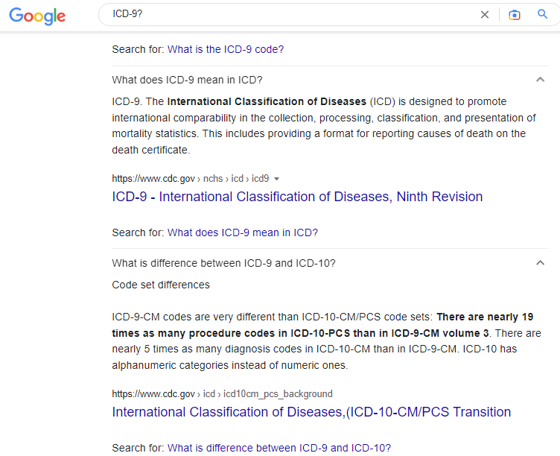
Notes:
CODE E78 CHANGE, SEARCH RESULT - 1

Slide 44
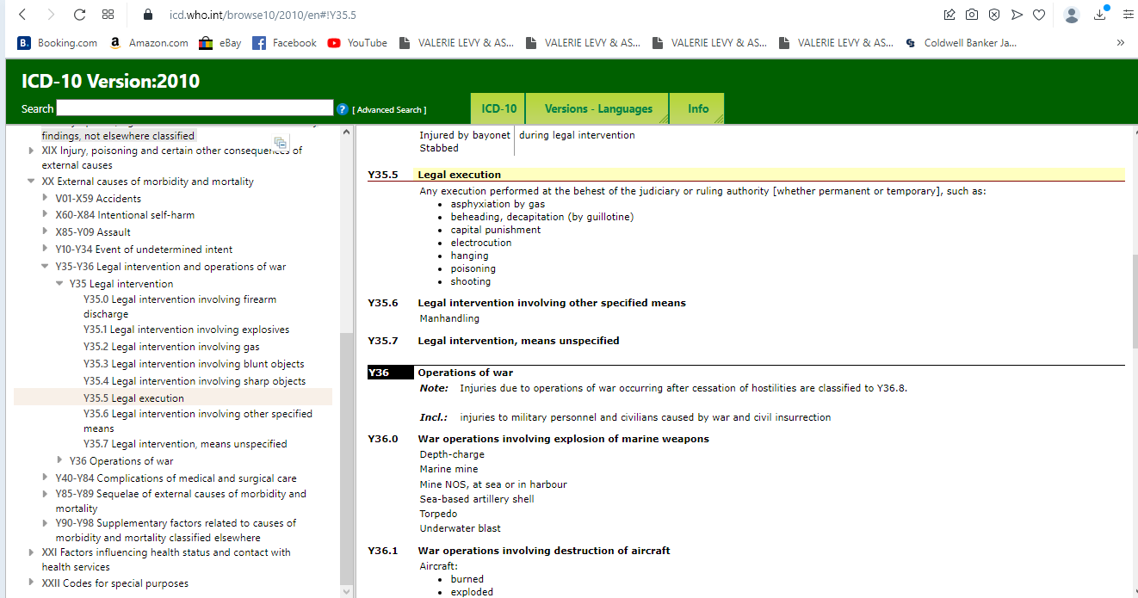
Notes:
CODE E78 CHANGE, SEARCH RESULT – 2 (now Y35.5 – “Legal Execution”)

Slide 45
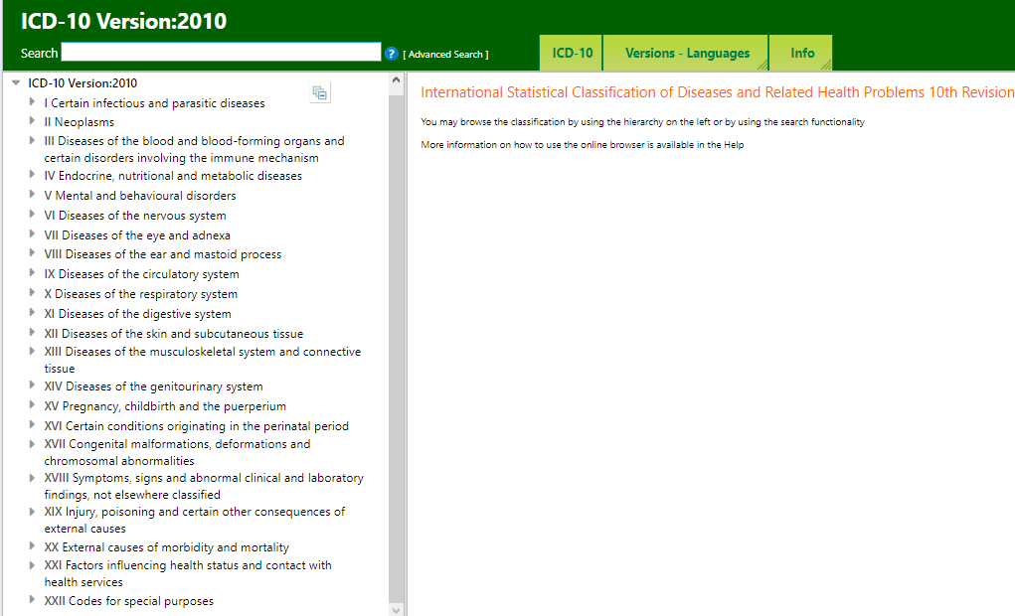

Slide 46
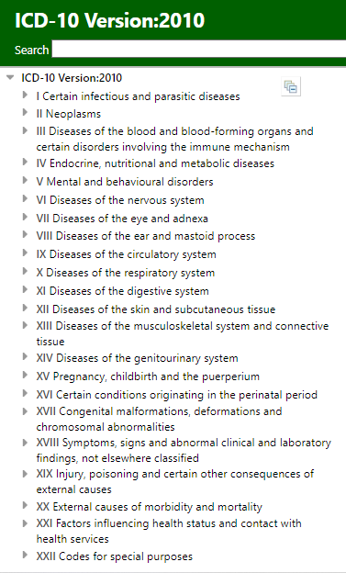

Slide 47
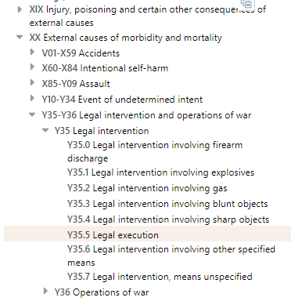

Slide 48
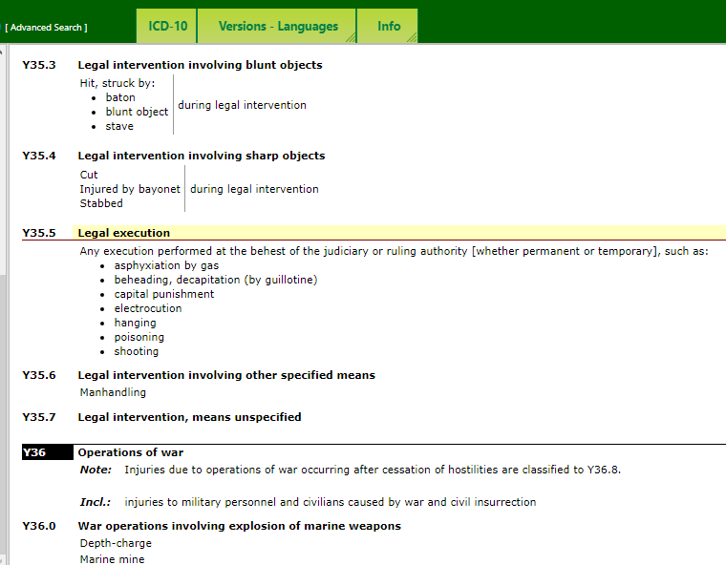

Slide 49
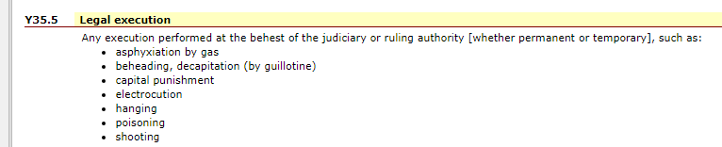
FORMERLY: ICD - CODE E78
NOW: CODE Y35.5 Legal execution
Notes:
FORMERLY: ICD - CODE E78 │CODE E78 CHANGE, SEARCH RESULT – 3 [Zoomed in] │Number 2 was added during the 2nd term of the Obama Administration: QUESTION: Why was this ICD CODE added / made so explicit / unquestionable what it is?
Also, please note carefully the Heading: Any execution performed at the behest of the judiciary or ruling authority {whether permanent or temporary}, such as:

Slide 50
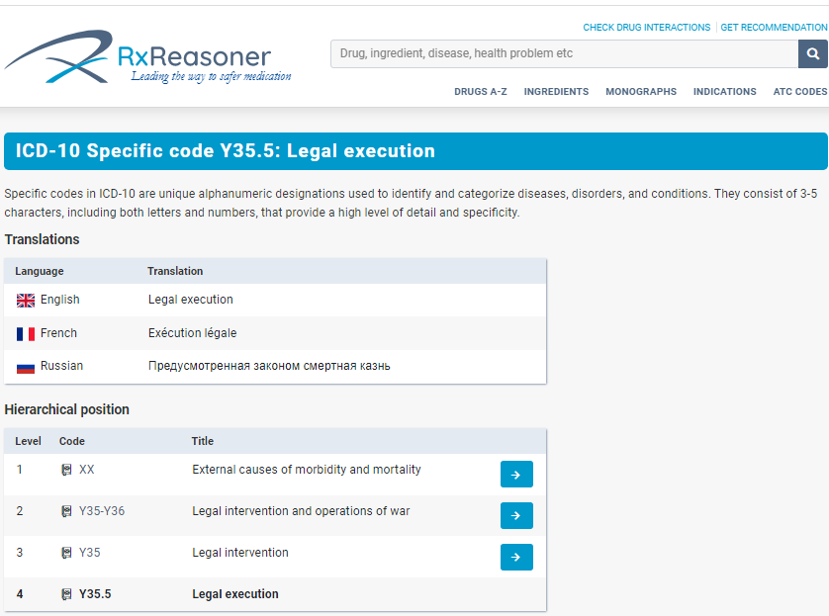
Notes:
SOURCE: https://www.rxreasoner.com/icd10codes/Y35.5 │February 27, 2023

Slide 51
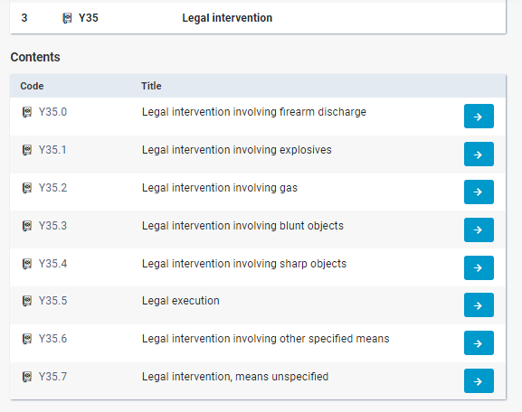
Notes:
SOURCE: https://www.rxreasoner.com/icd10codes/Y35.5 │February 27, 2023

Slide 52
QUESTIONS?
DISCUSSION

Slide 53
https://ellenwhite.org/topics/372
On “Sunday Laws”

